Slide 1
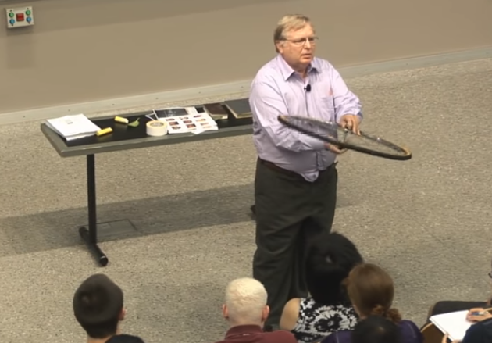
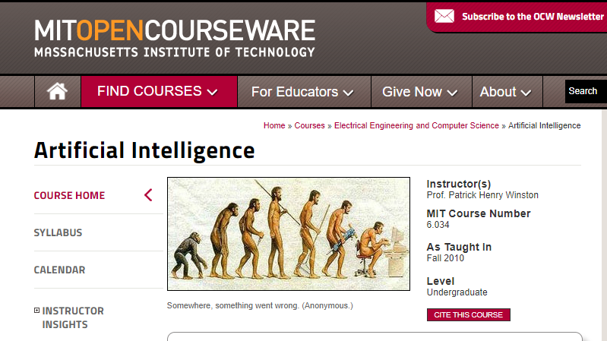
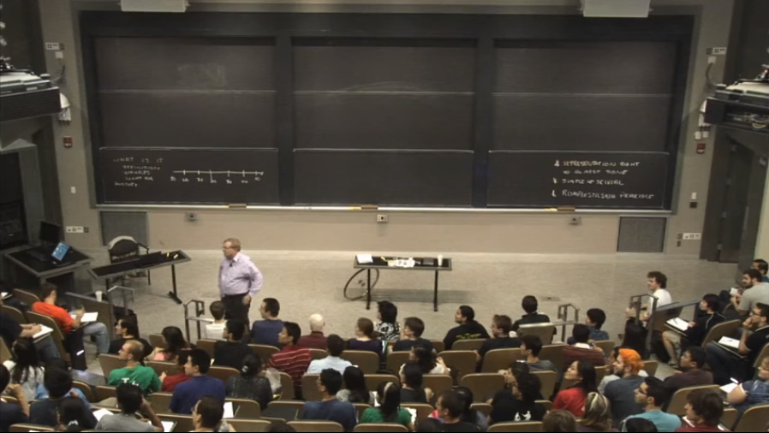
Intro

Slide 2

Intro

Slide 3
Intro

Slide 4
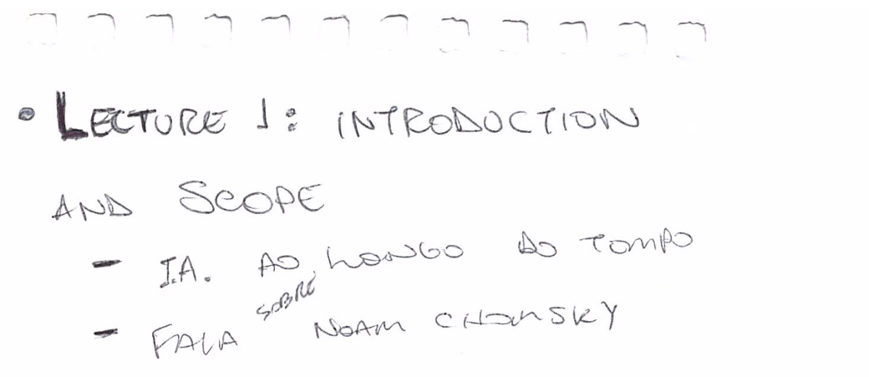
Lecture 1: Introduction and Scope
"It seems that shortly before 50,000 years ago, some small group of us acquired the ability to take two concepts, and combine them to make a third concept, without disturbing the original two concepts, without limit." And from a perspective of an AI person like me, what Chomsky seems to be saying is, we learned how to begin to describe things, in a way that was intimately connected with language.

Slide 5
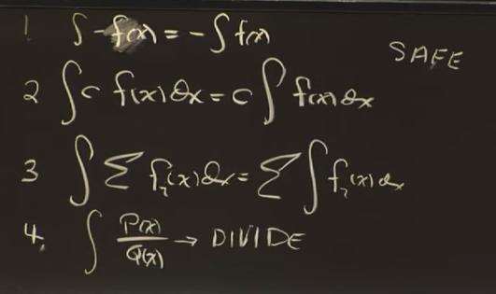

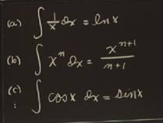
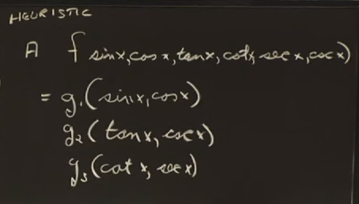
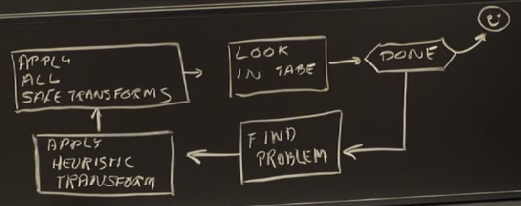
Lecture 2: Reasoning: Goal Trees and Problem Solving

Slide 6
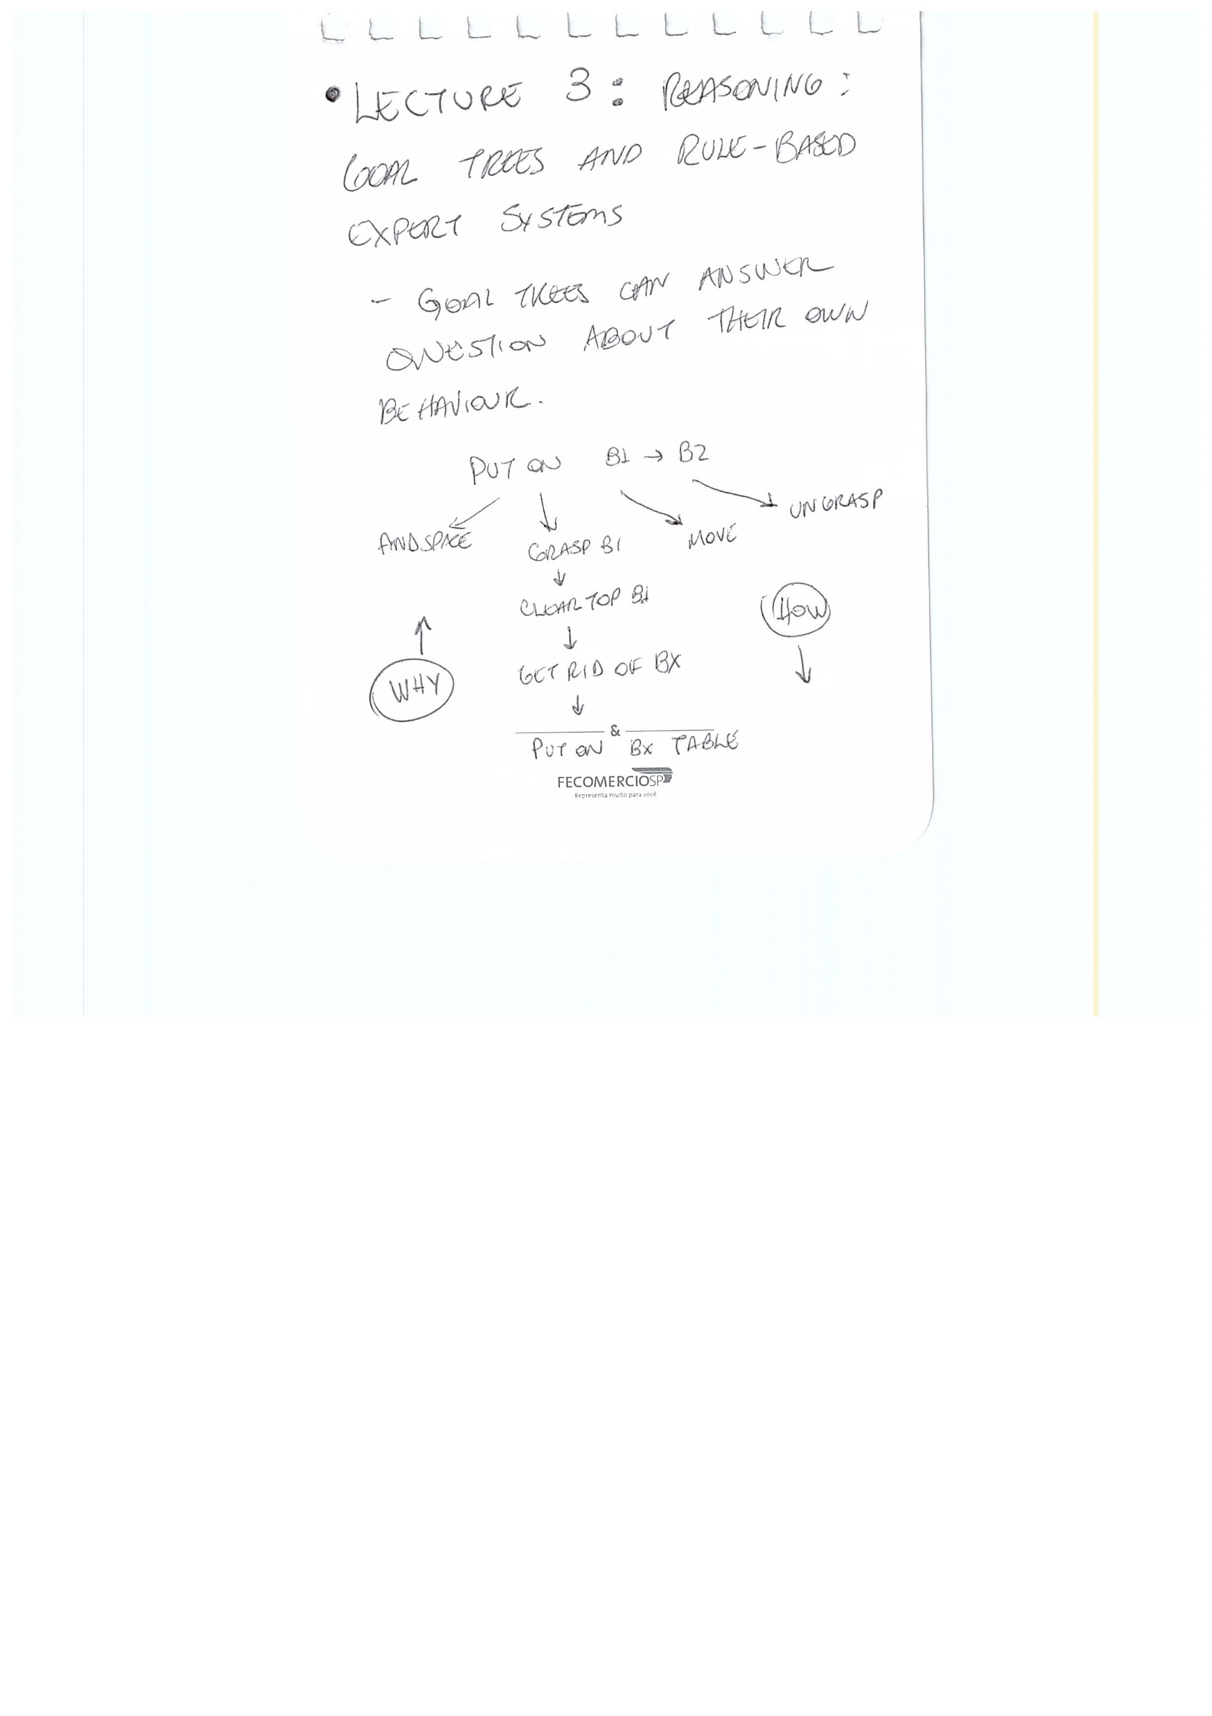
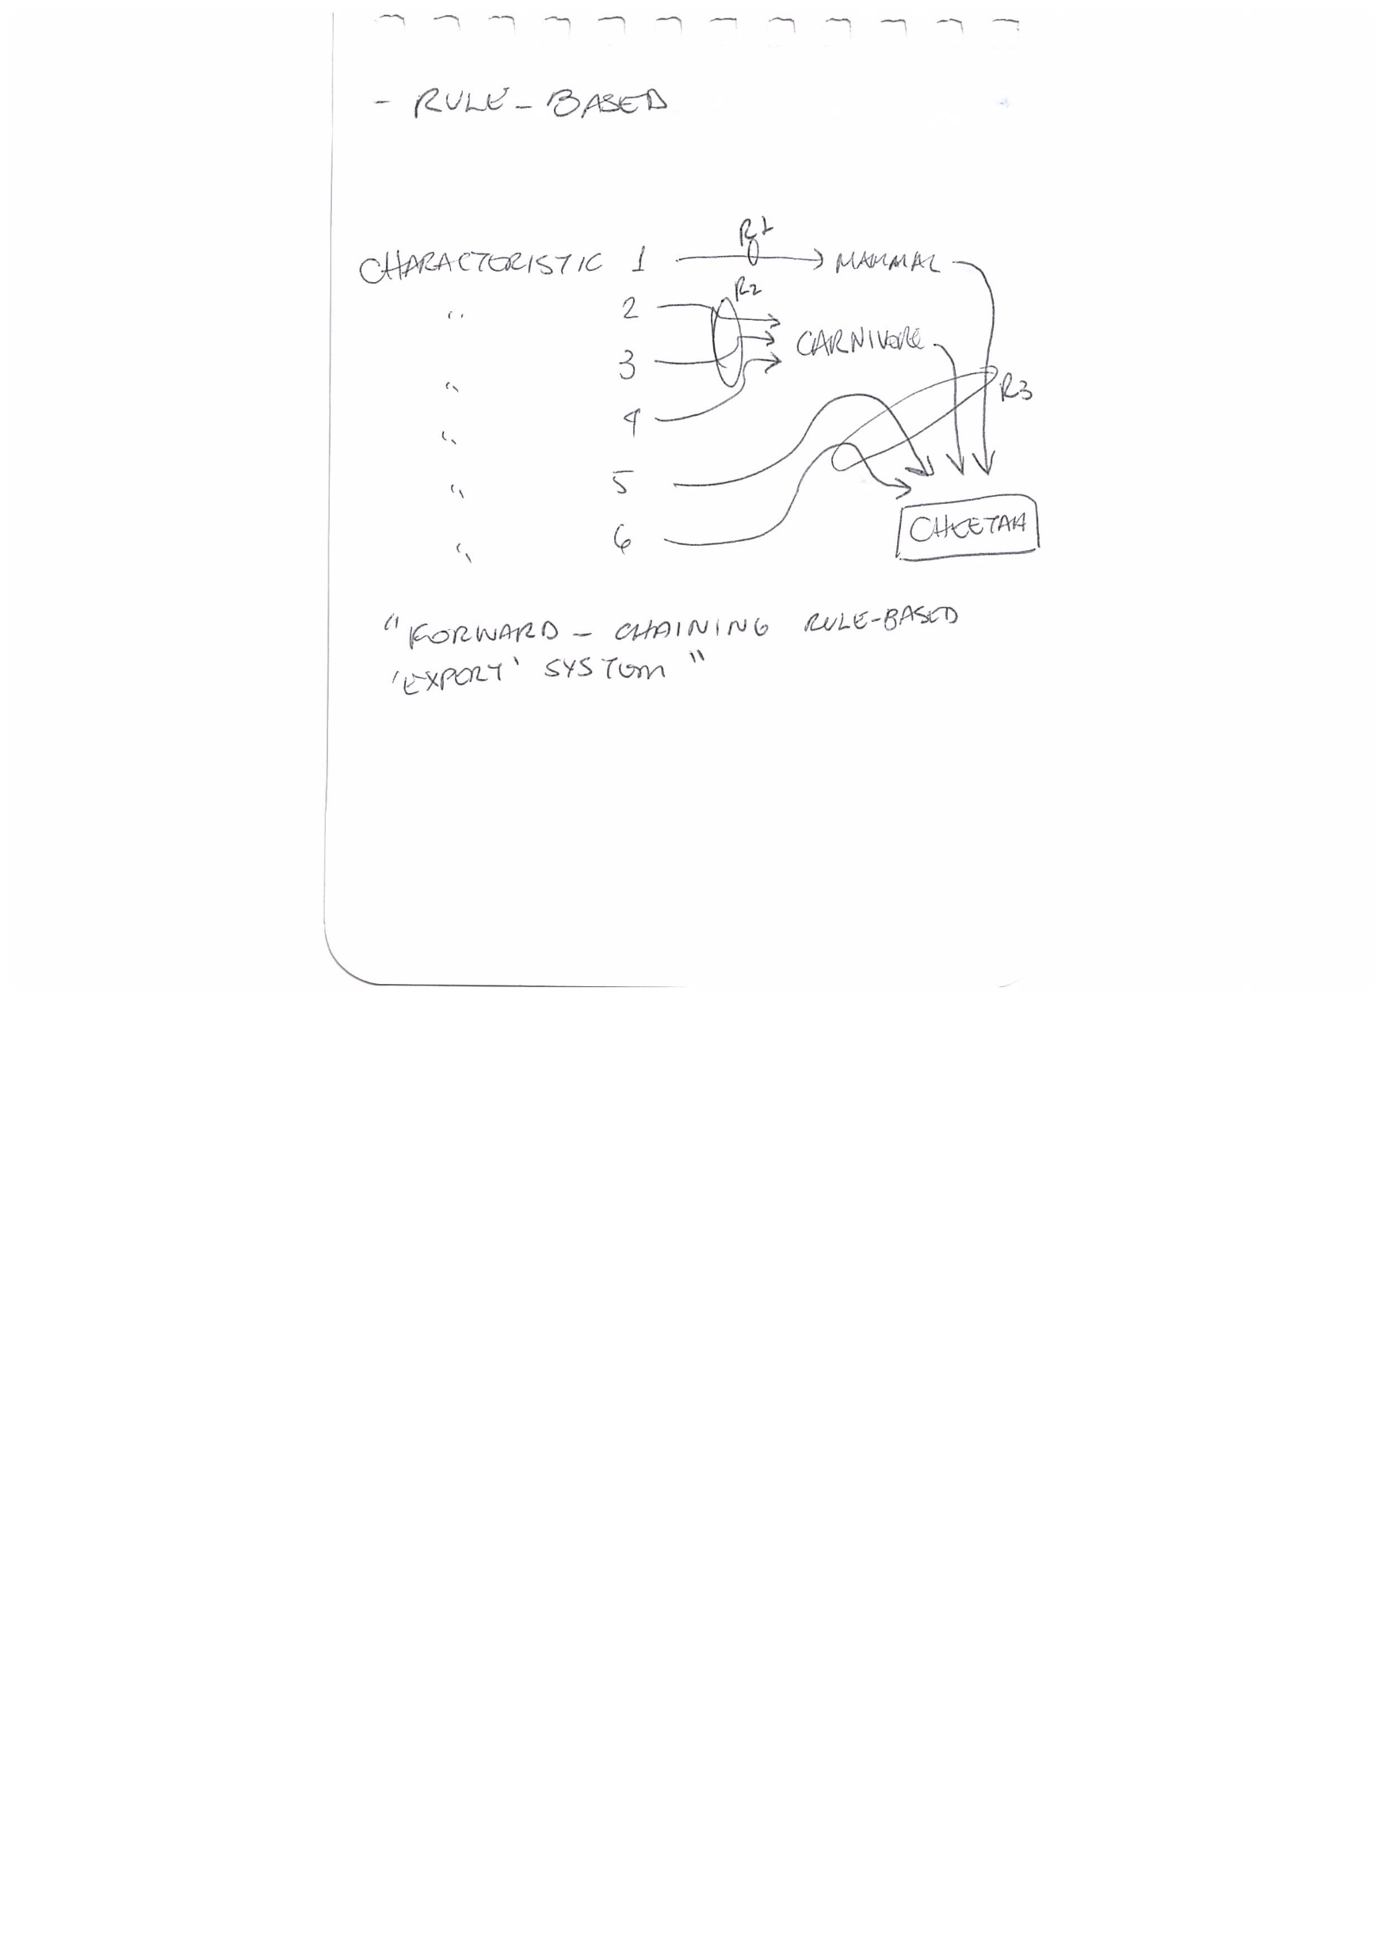
Lecture 3: Reasoning: Goal Trees and Rule-Based Expert Systems

Slide 7
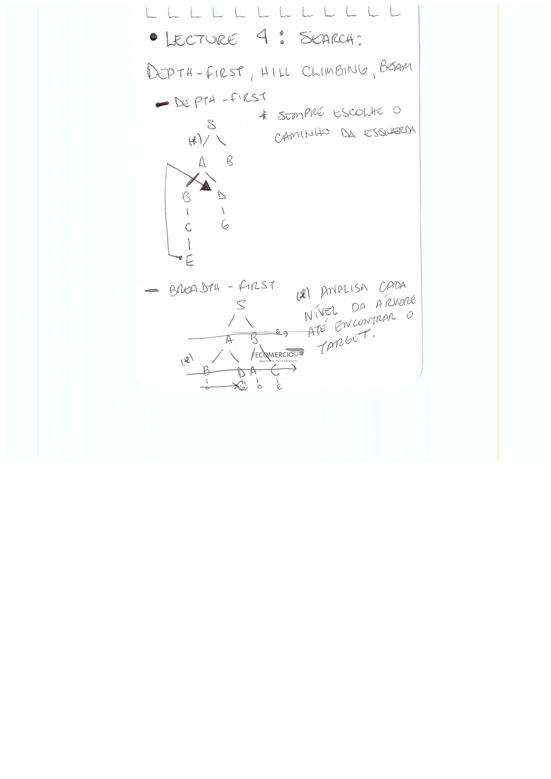
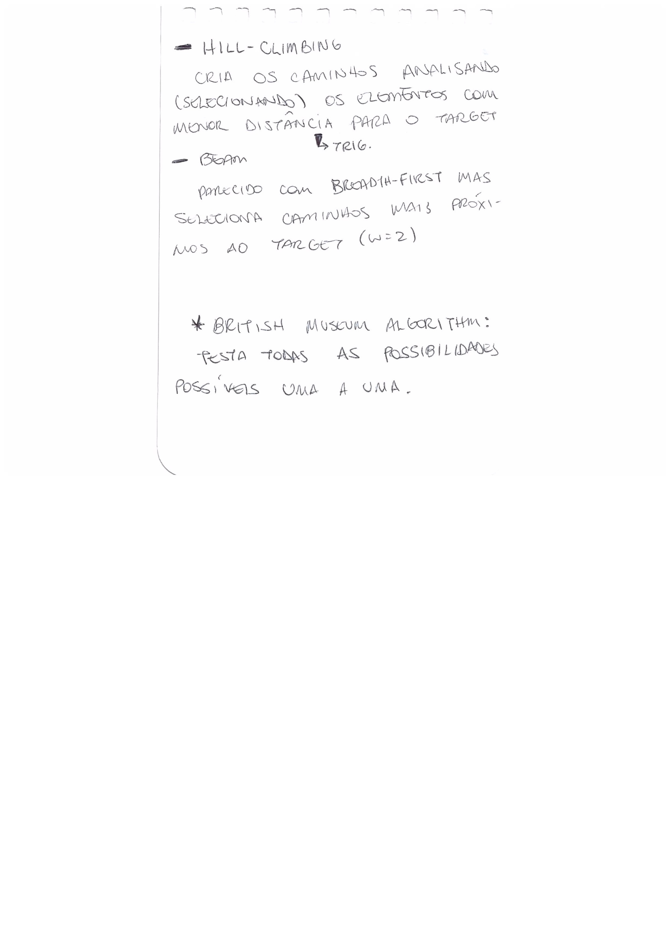
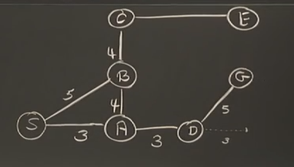
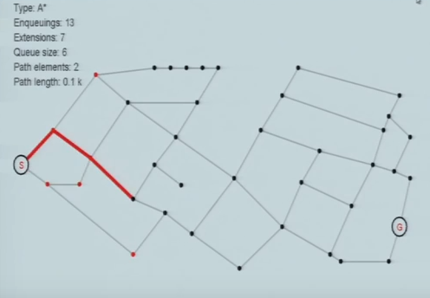
Lecture 4: Search: Depth-First, Hill Climbing, Beam

Slide 8
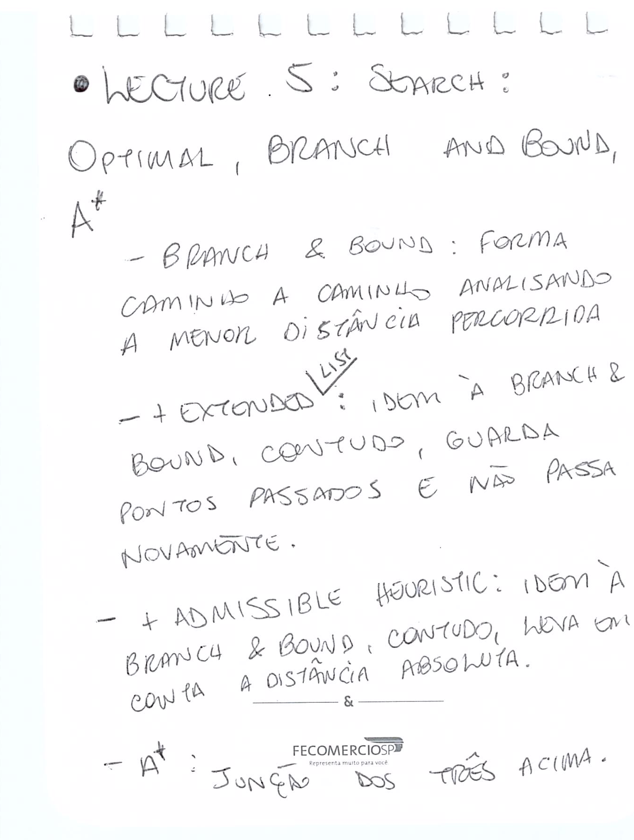
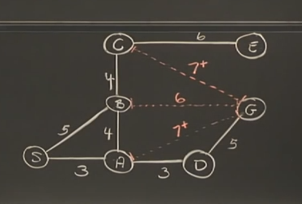
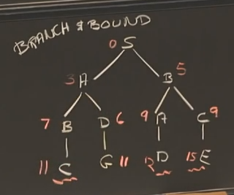
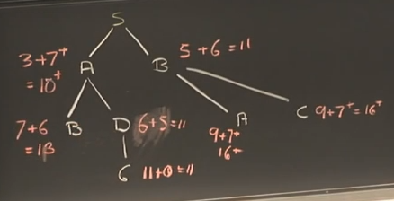
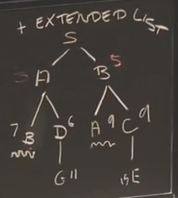
Lecture 5: Search: Optimal, Branch and Bound, A*
ADMISSIBLE HEURISTIC

Slide 9
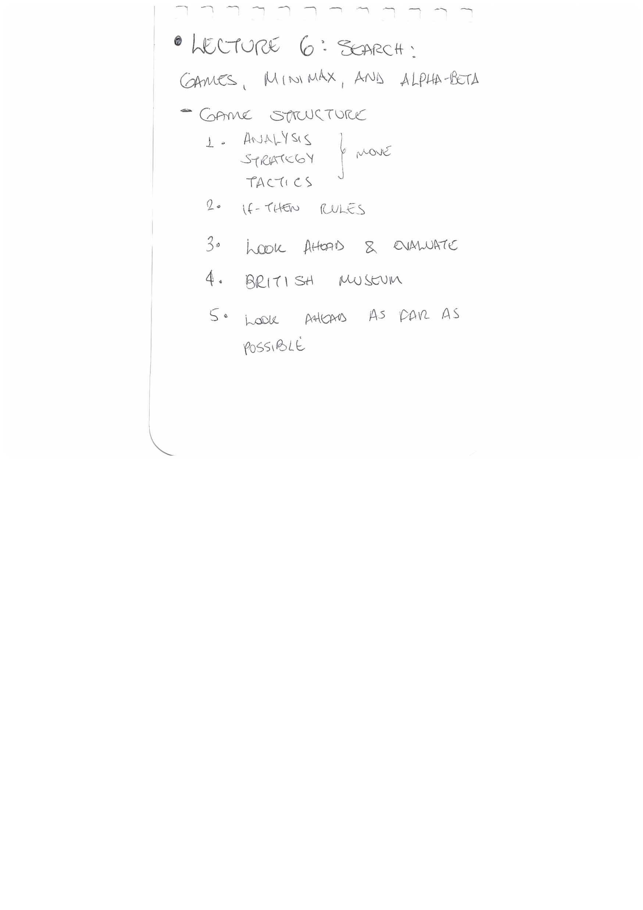
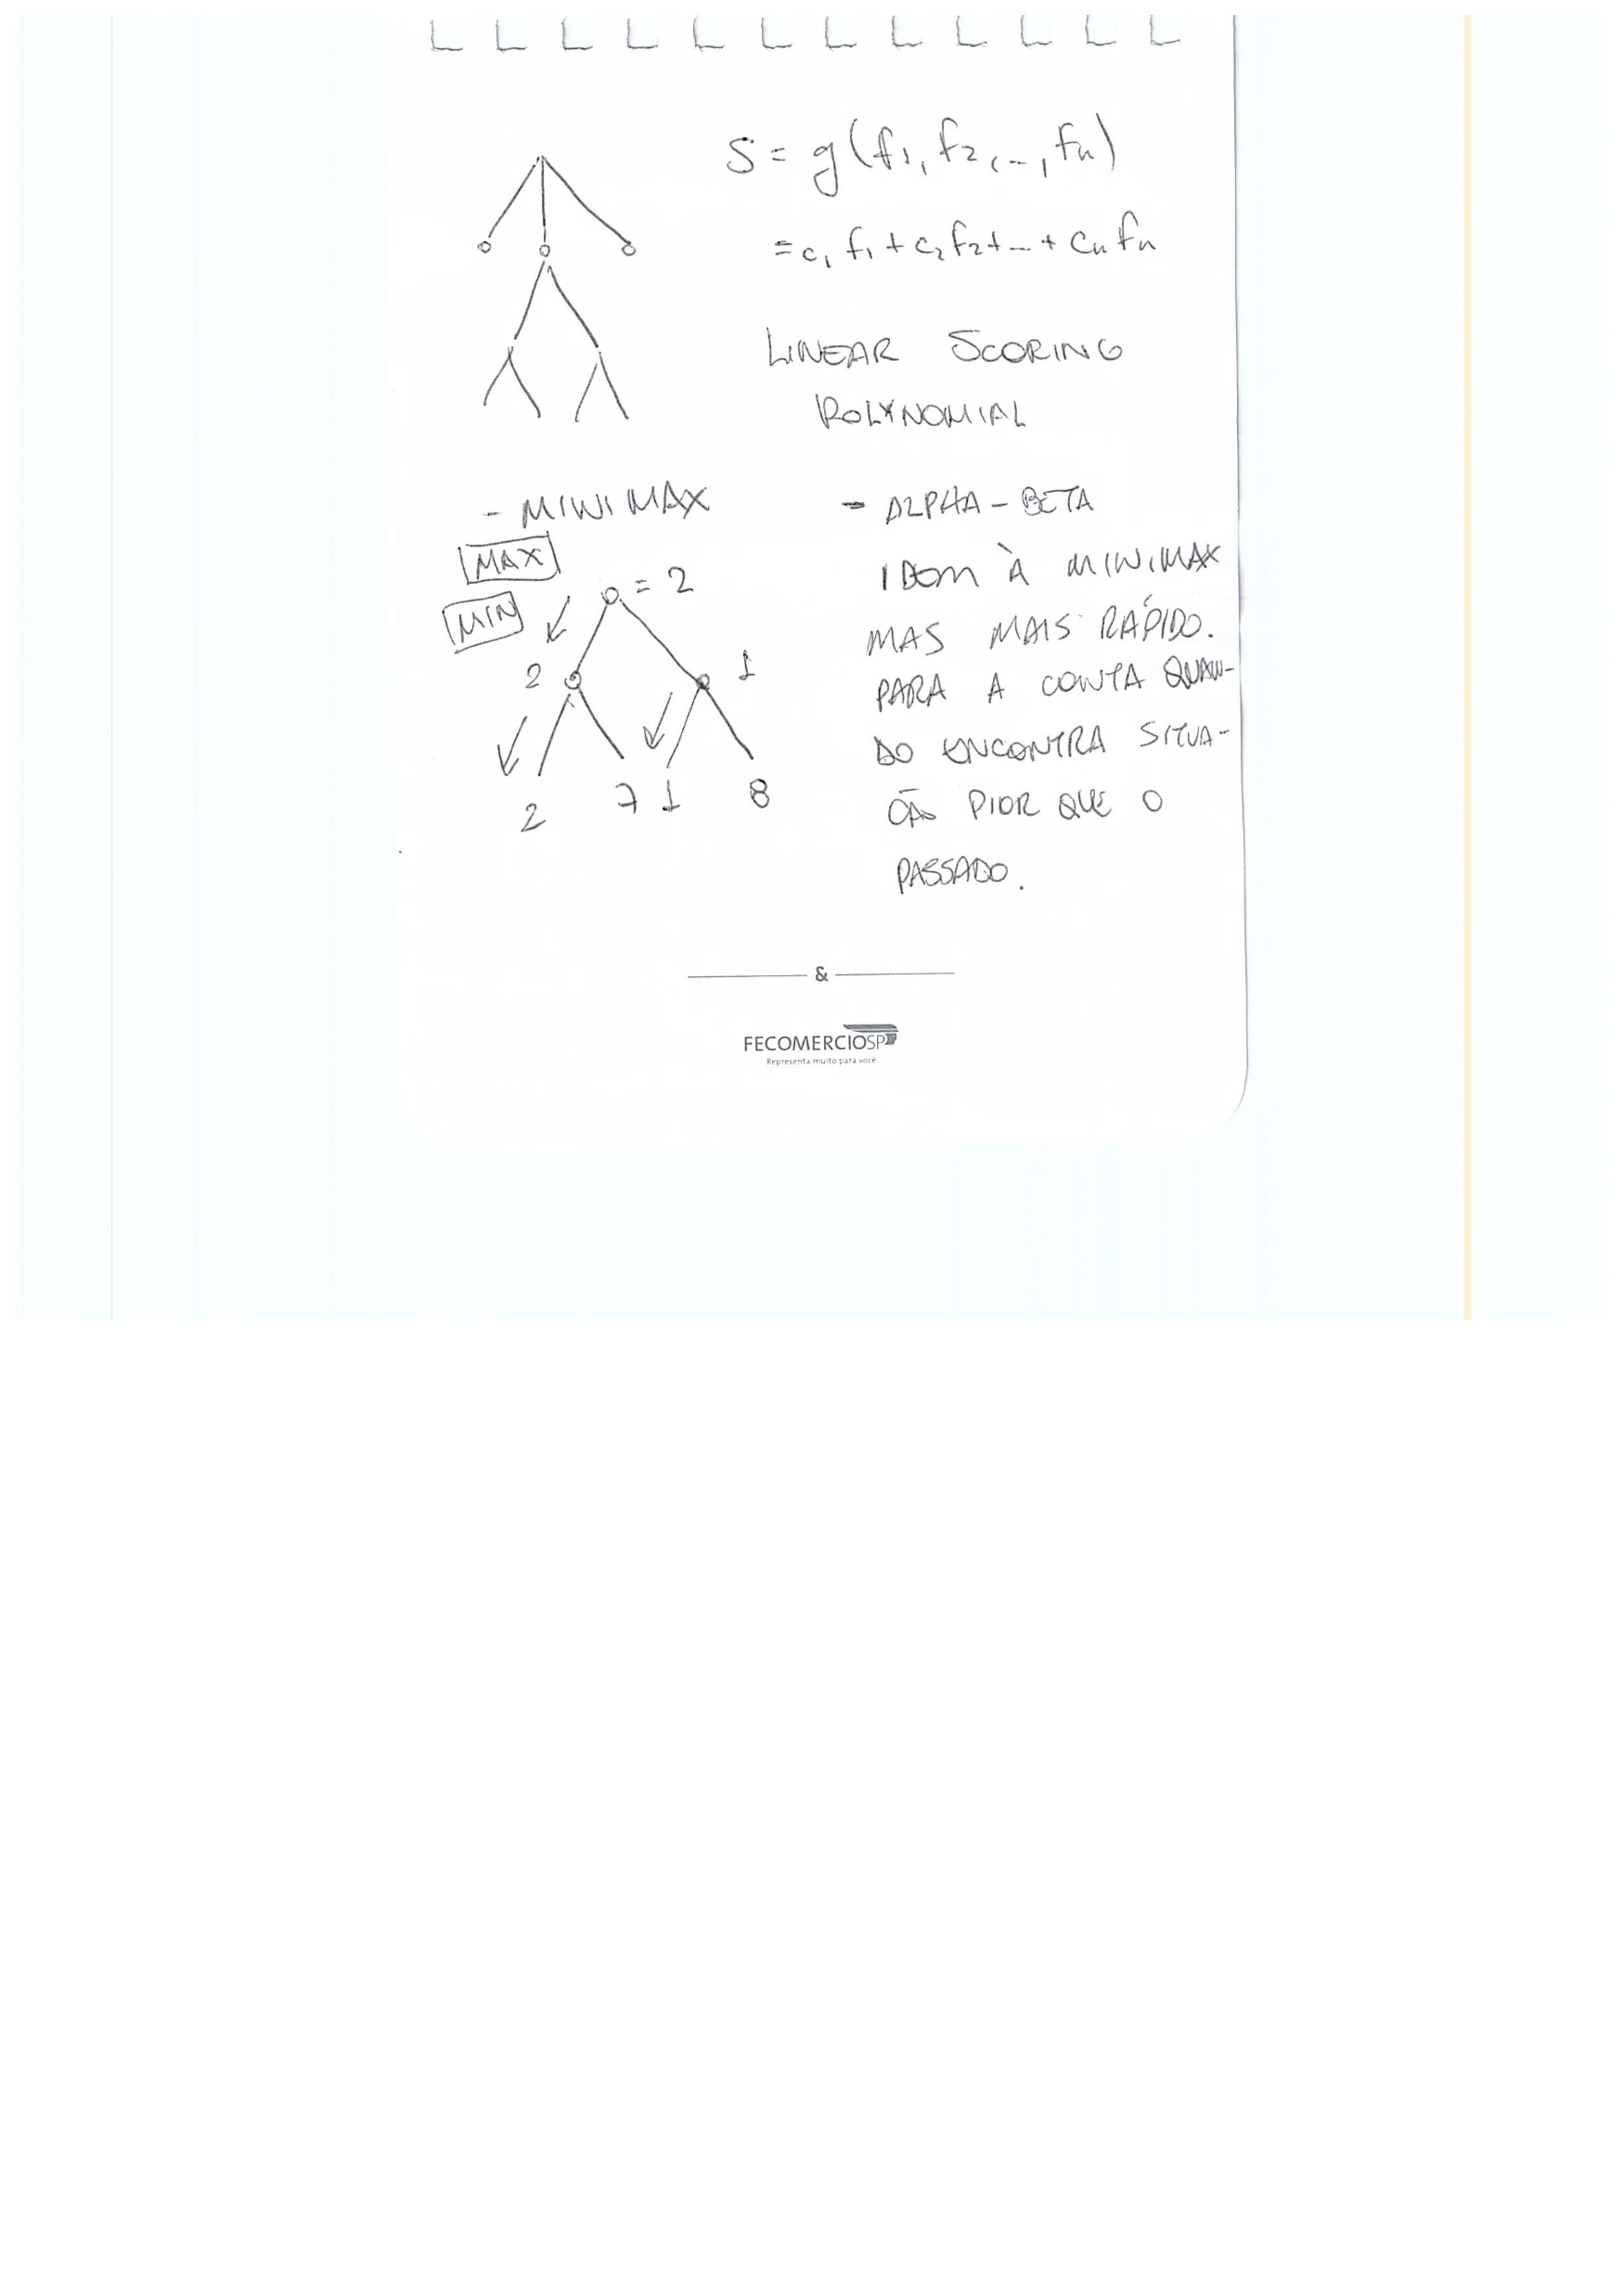
Lecture 6: Search: Games, Minimax, and Alpha-Beta
Examplo de MINIMAX
um jogador quer o maior valor
um jogador quer o menor valor

Slide 10
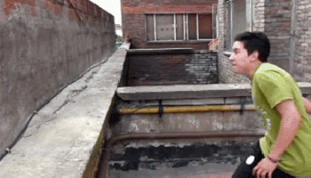
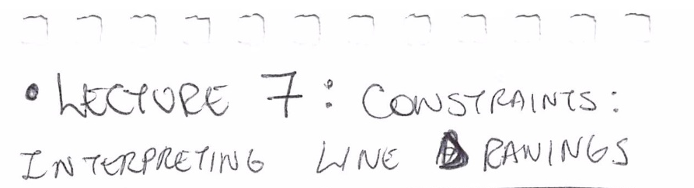

Lecture 7: Constraints: Interpreting Line Drawings

Slide 11
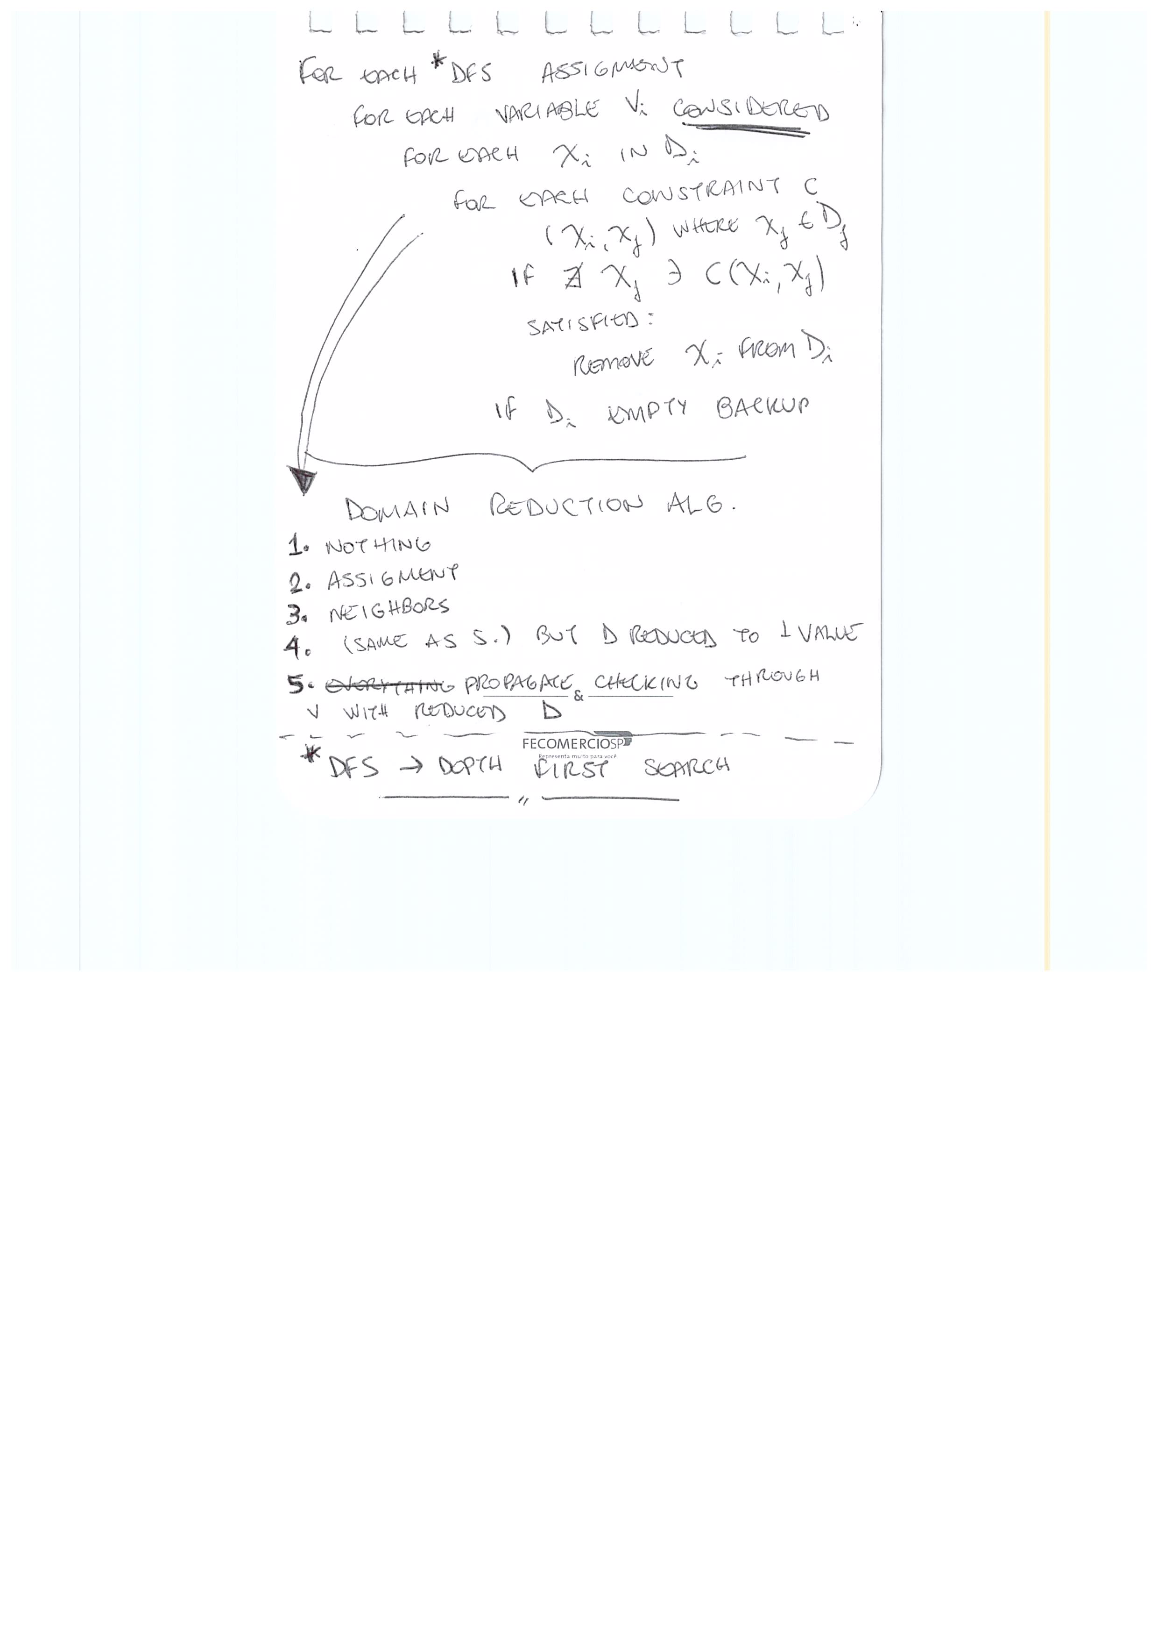
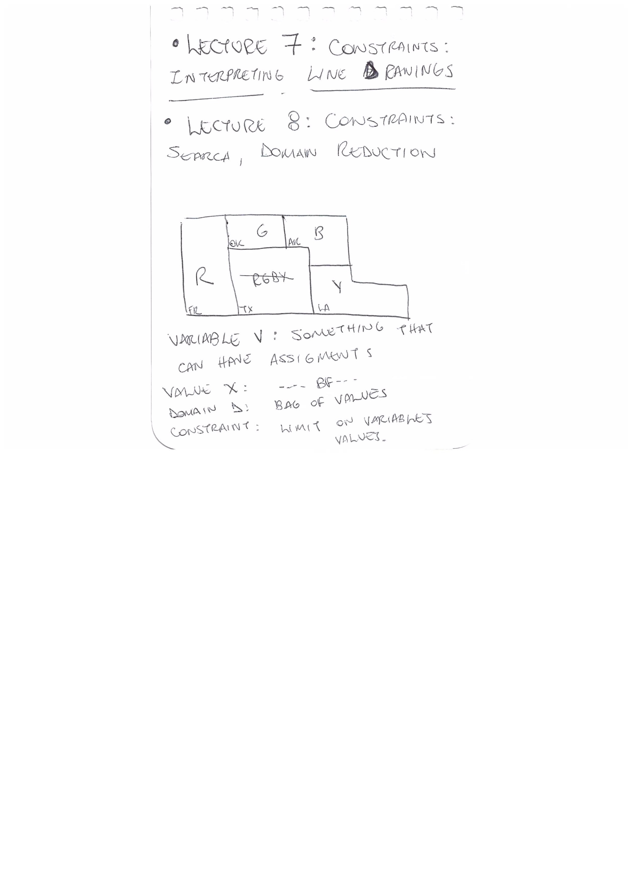
Lecture 8: Constraints: Search, Domain Reduction

Slide 12
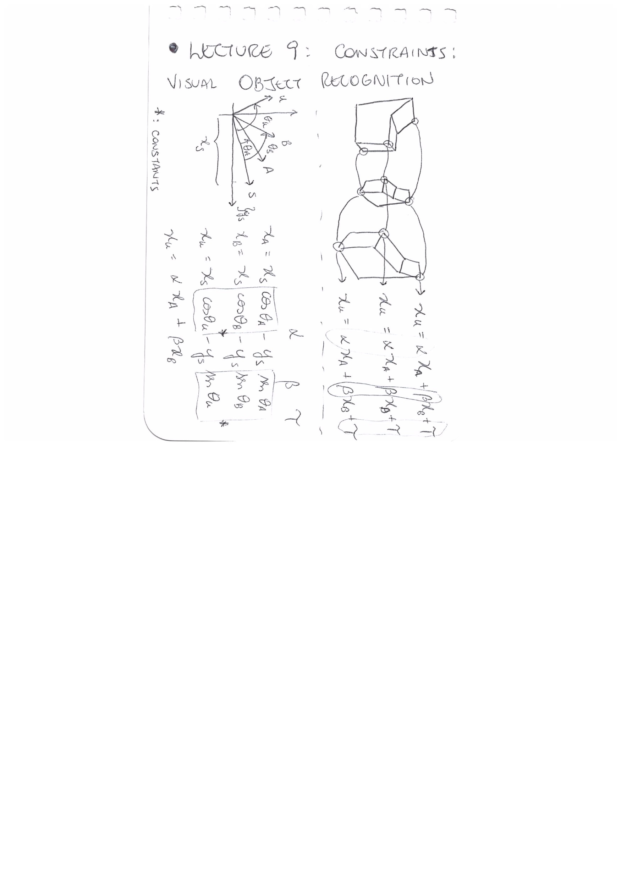
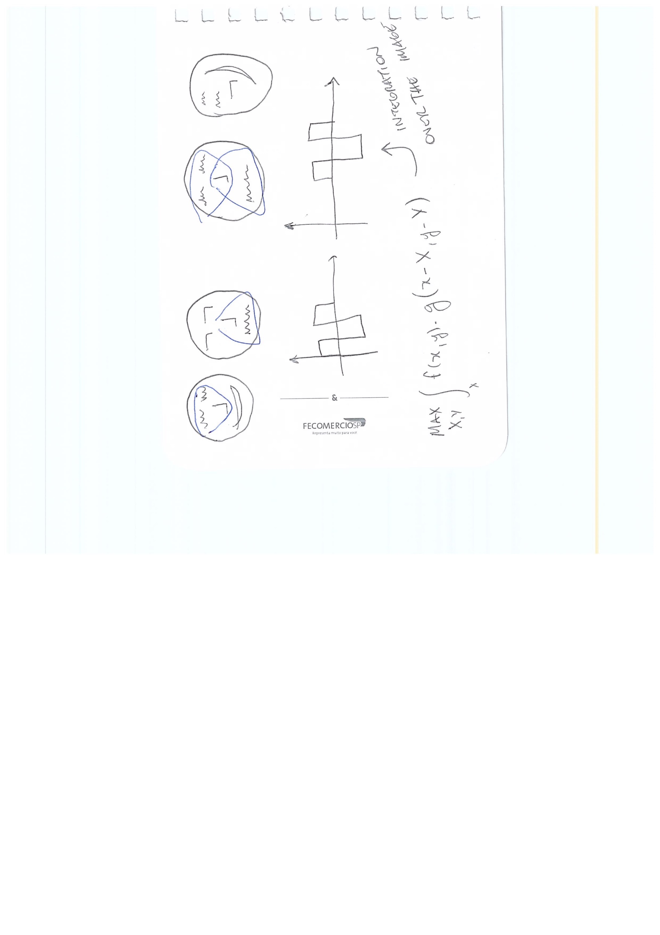
Lecture 9: Constraints: Visual Object Recognition
A
B
U

Slide 13
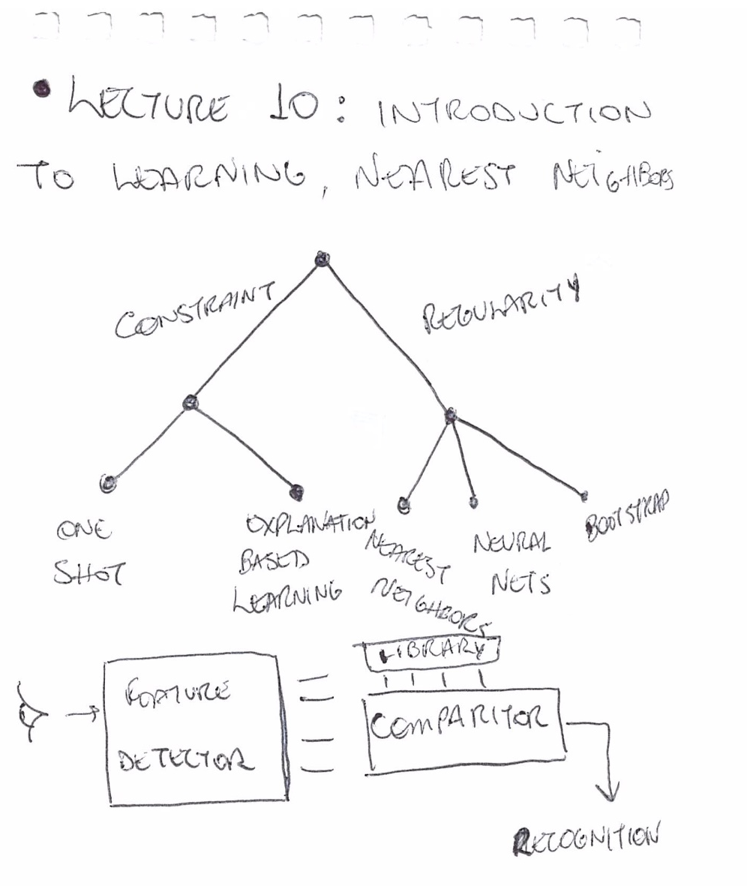
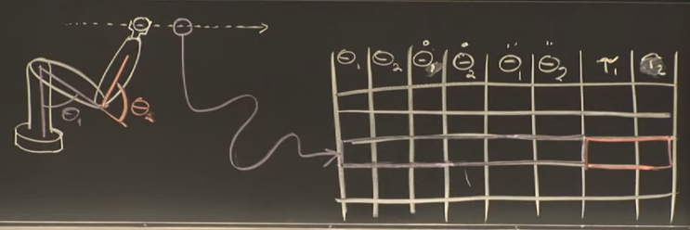
Lecture 10: Introduction to Learning, Nearest Neighbors

Slide 14
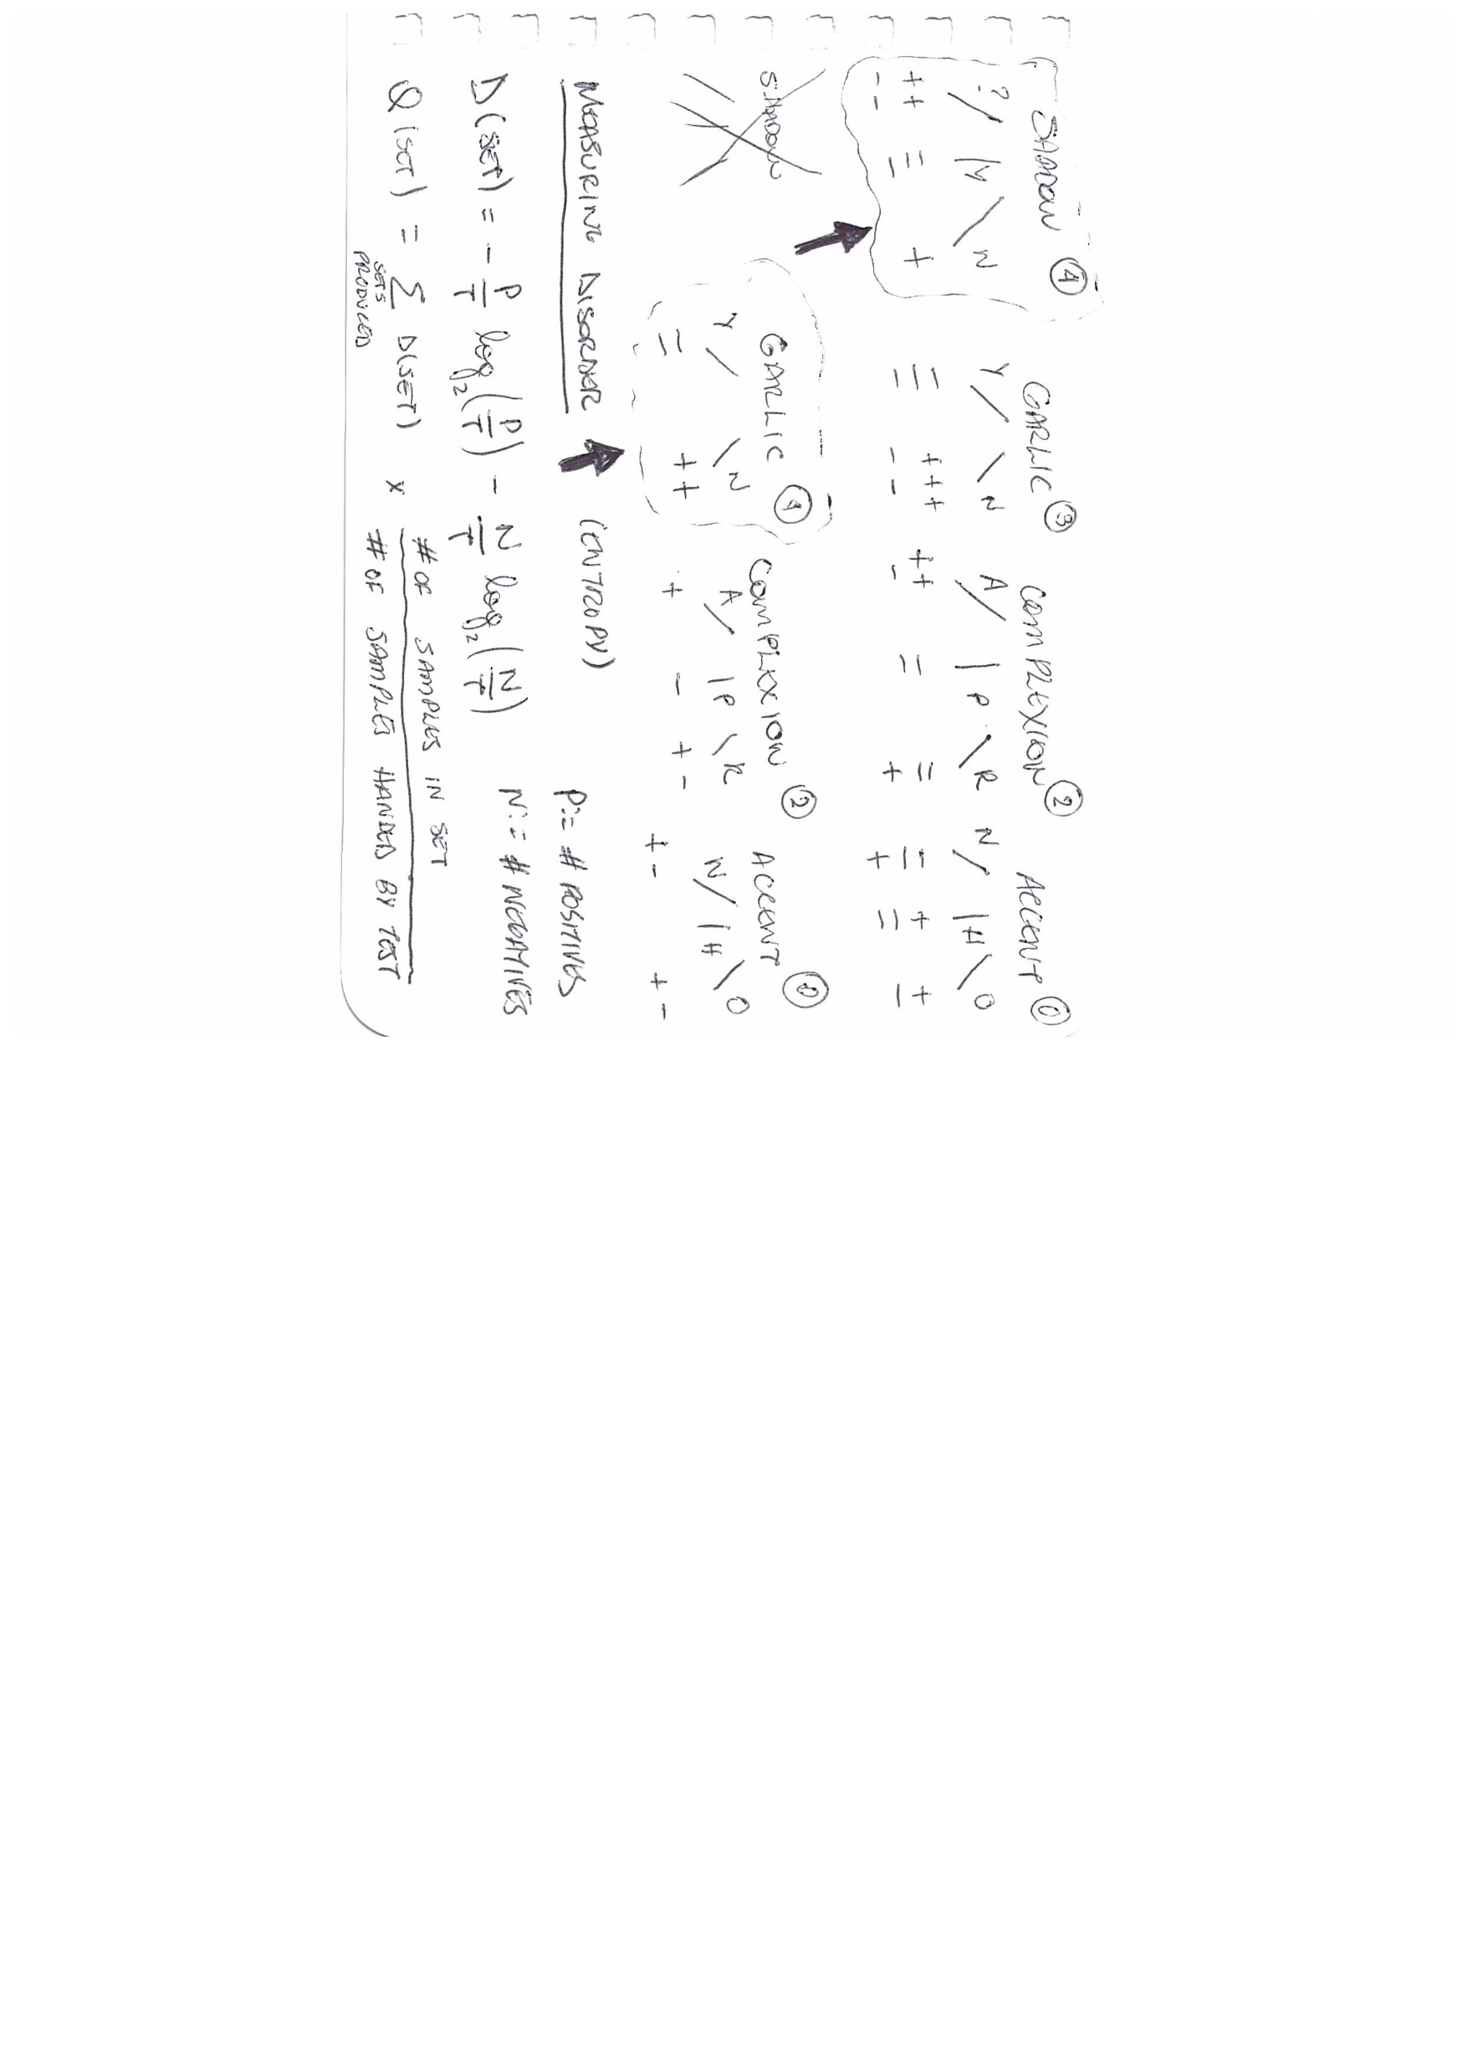
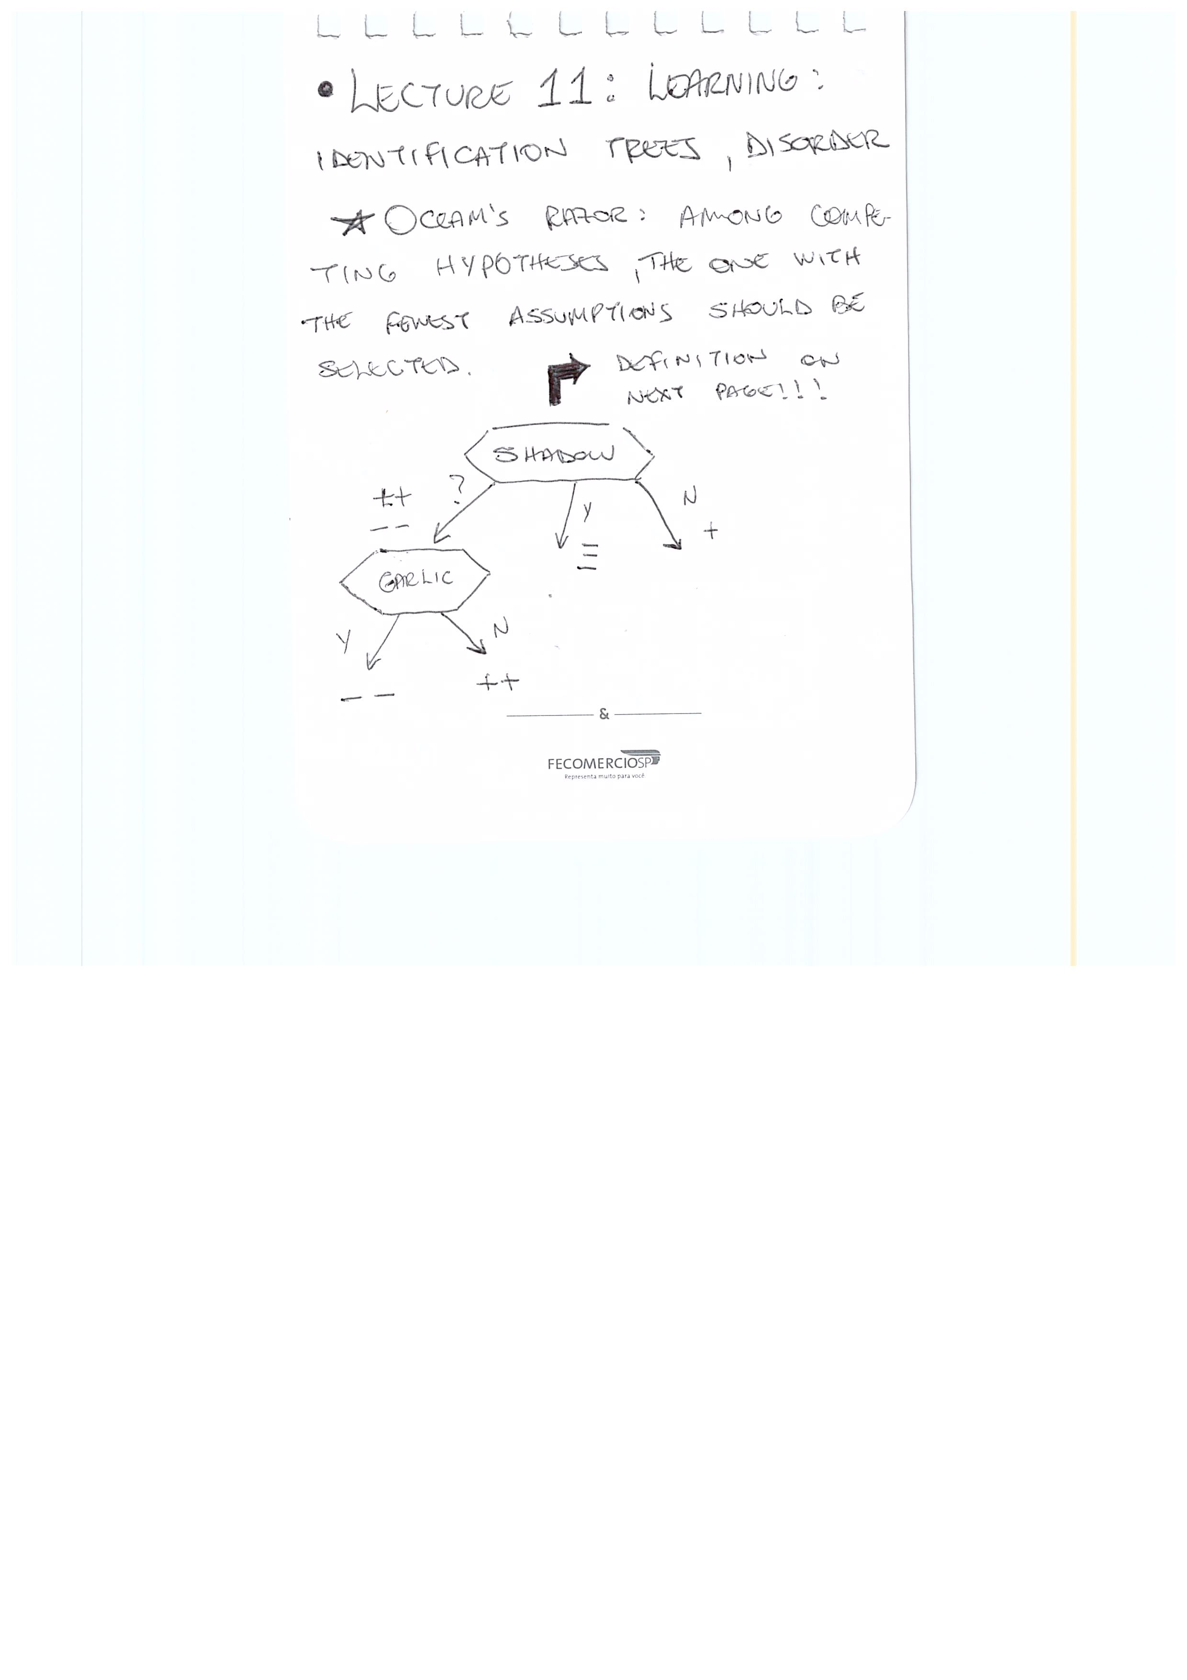
Lecture 11: Learning: Identification Trees, Disorder
1
2

Slide 15
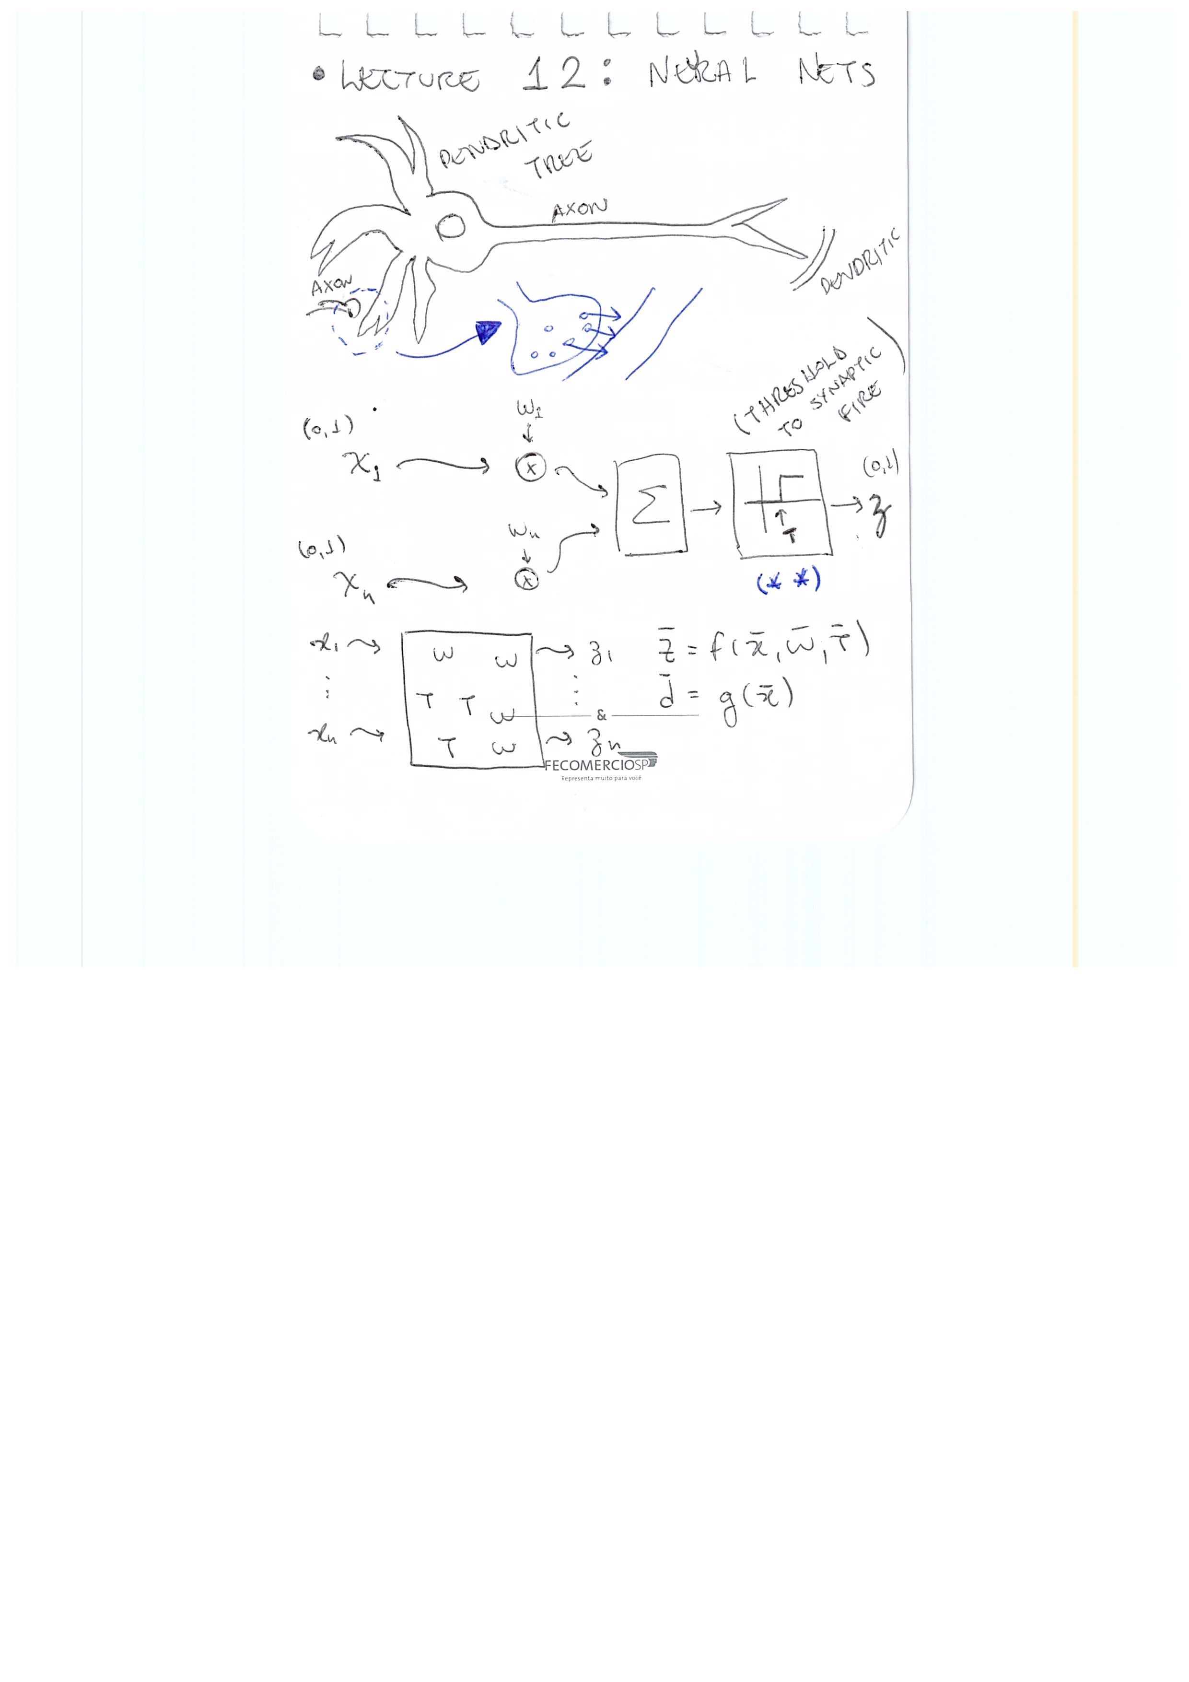
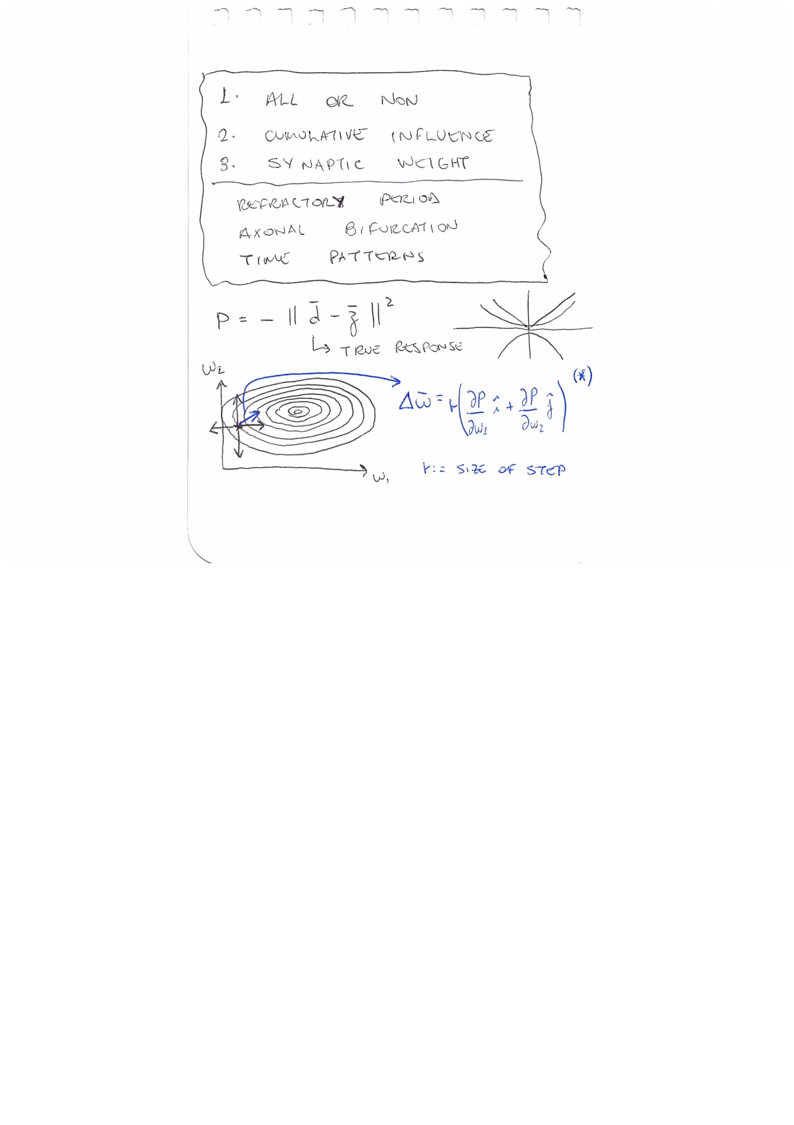
Lecture 12: Neural Nets

Slide 16
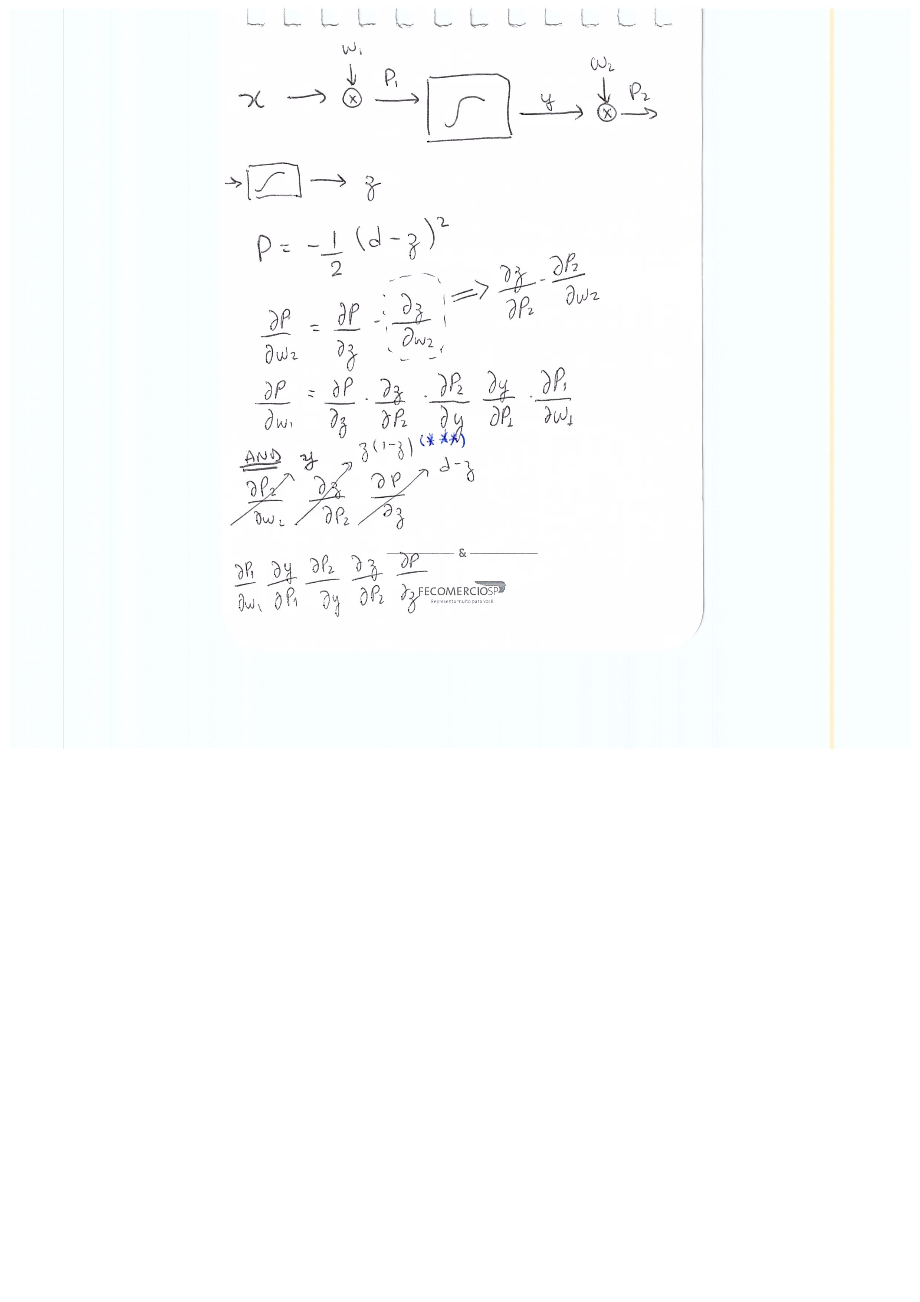
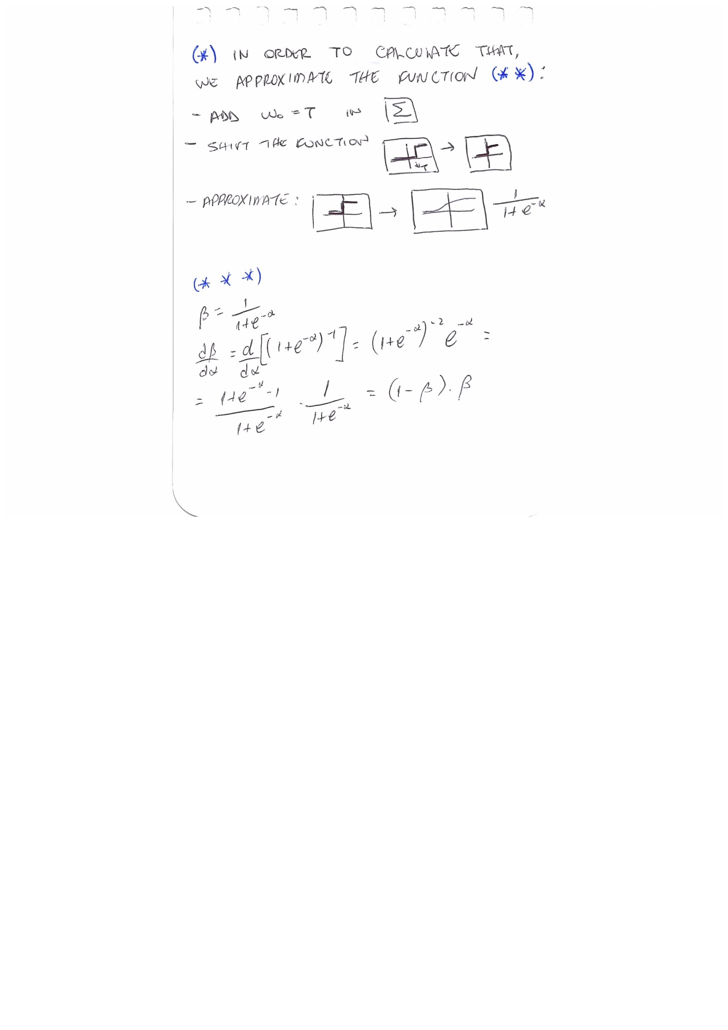
Lecture 12: Neural Nets

Slide 17
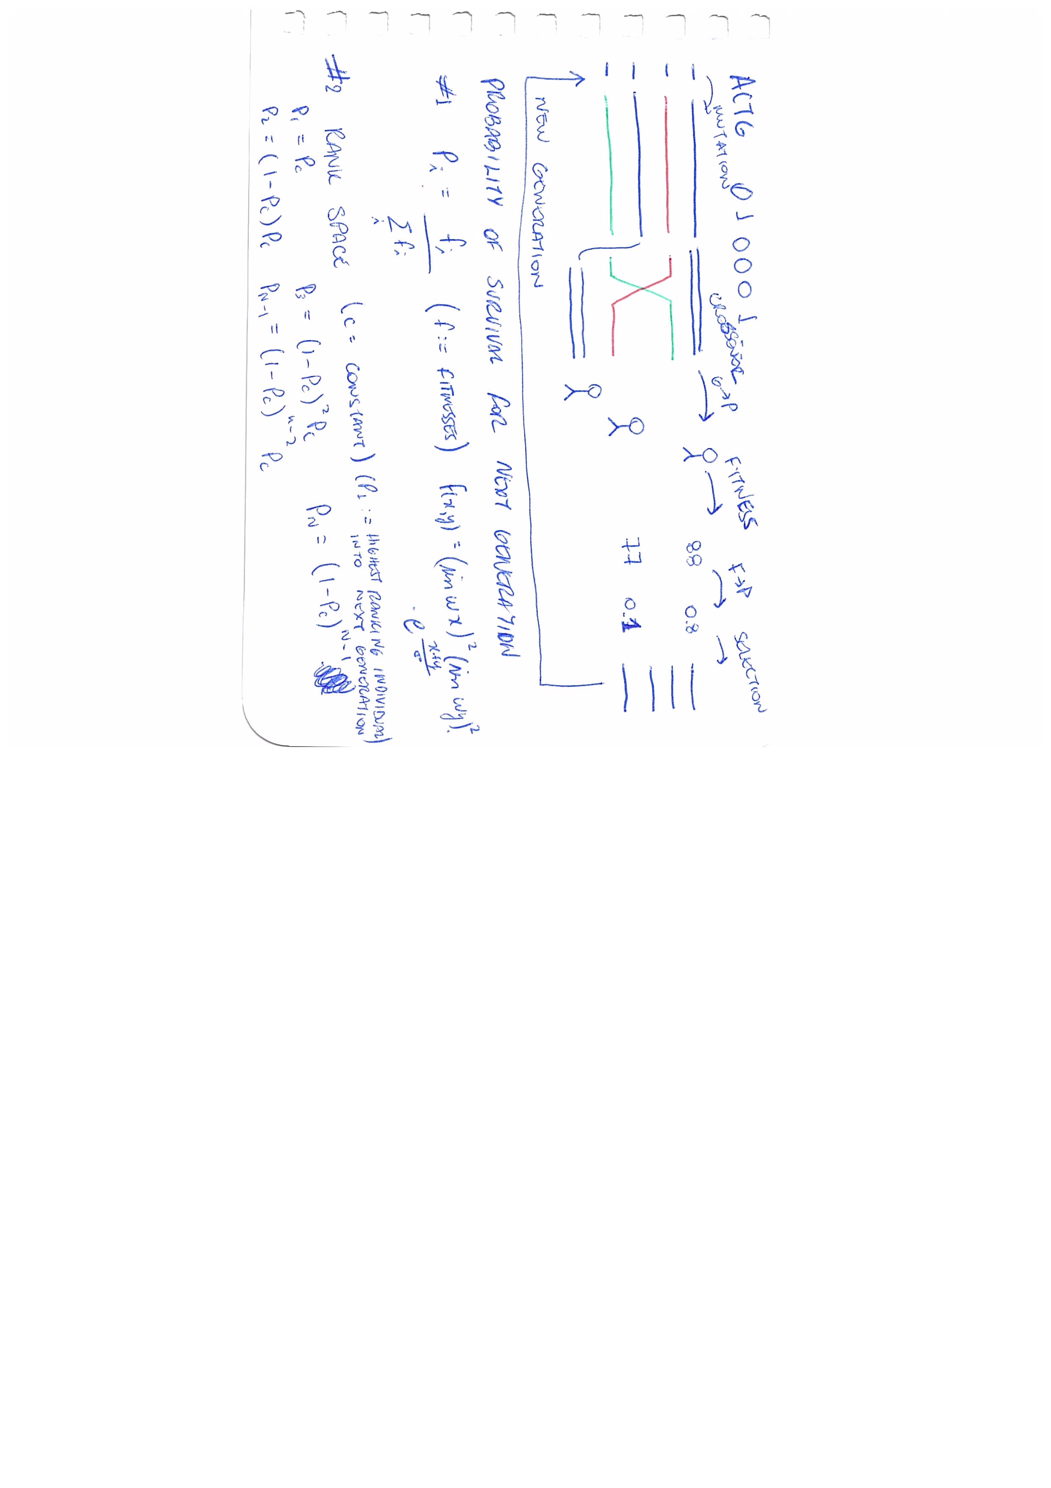
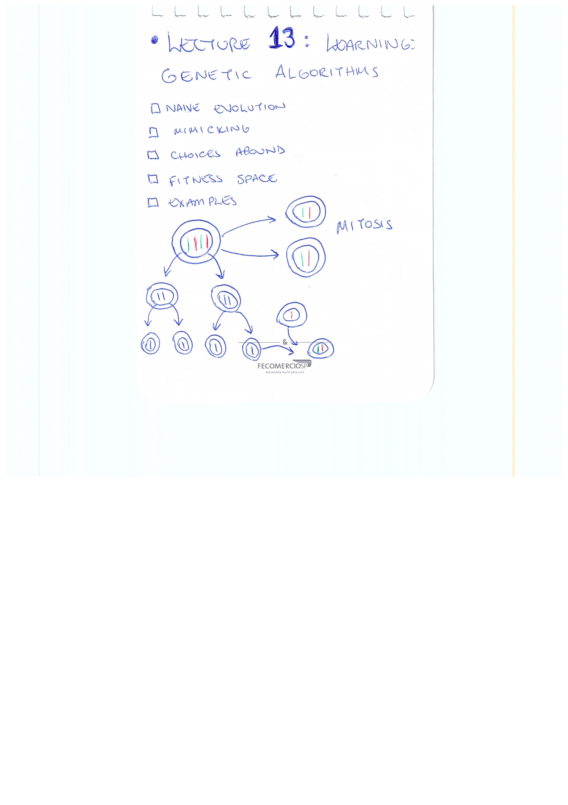
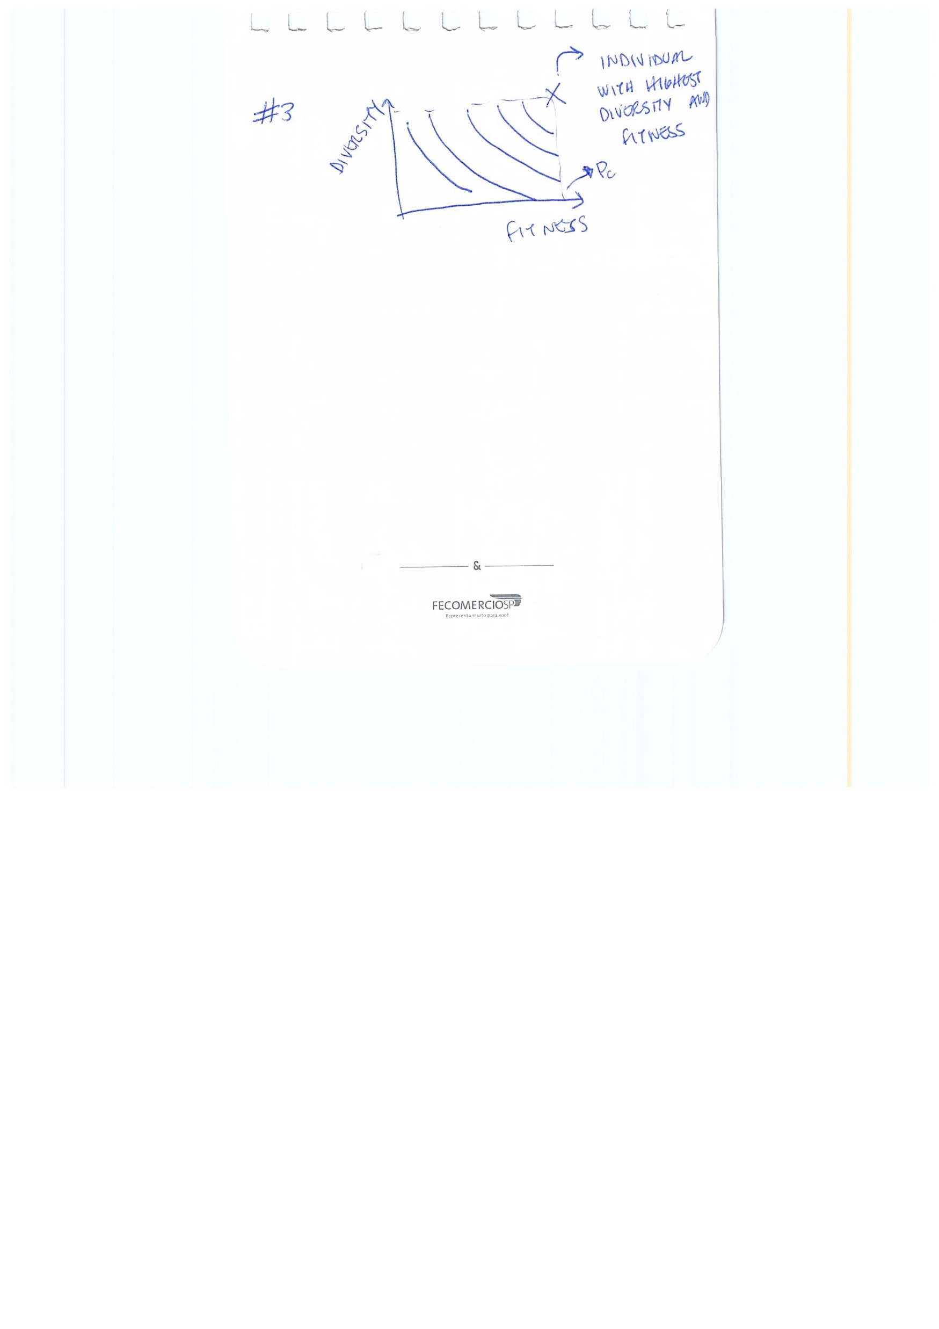
Lecture 13: Learning: Genetic Algorithms

Slide 18
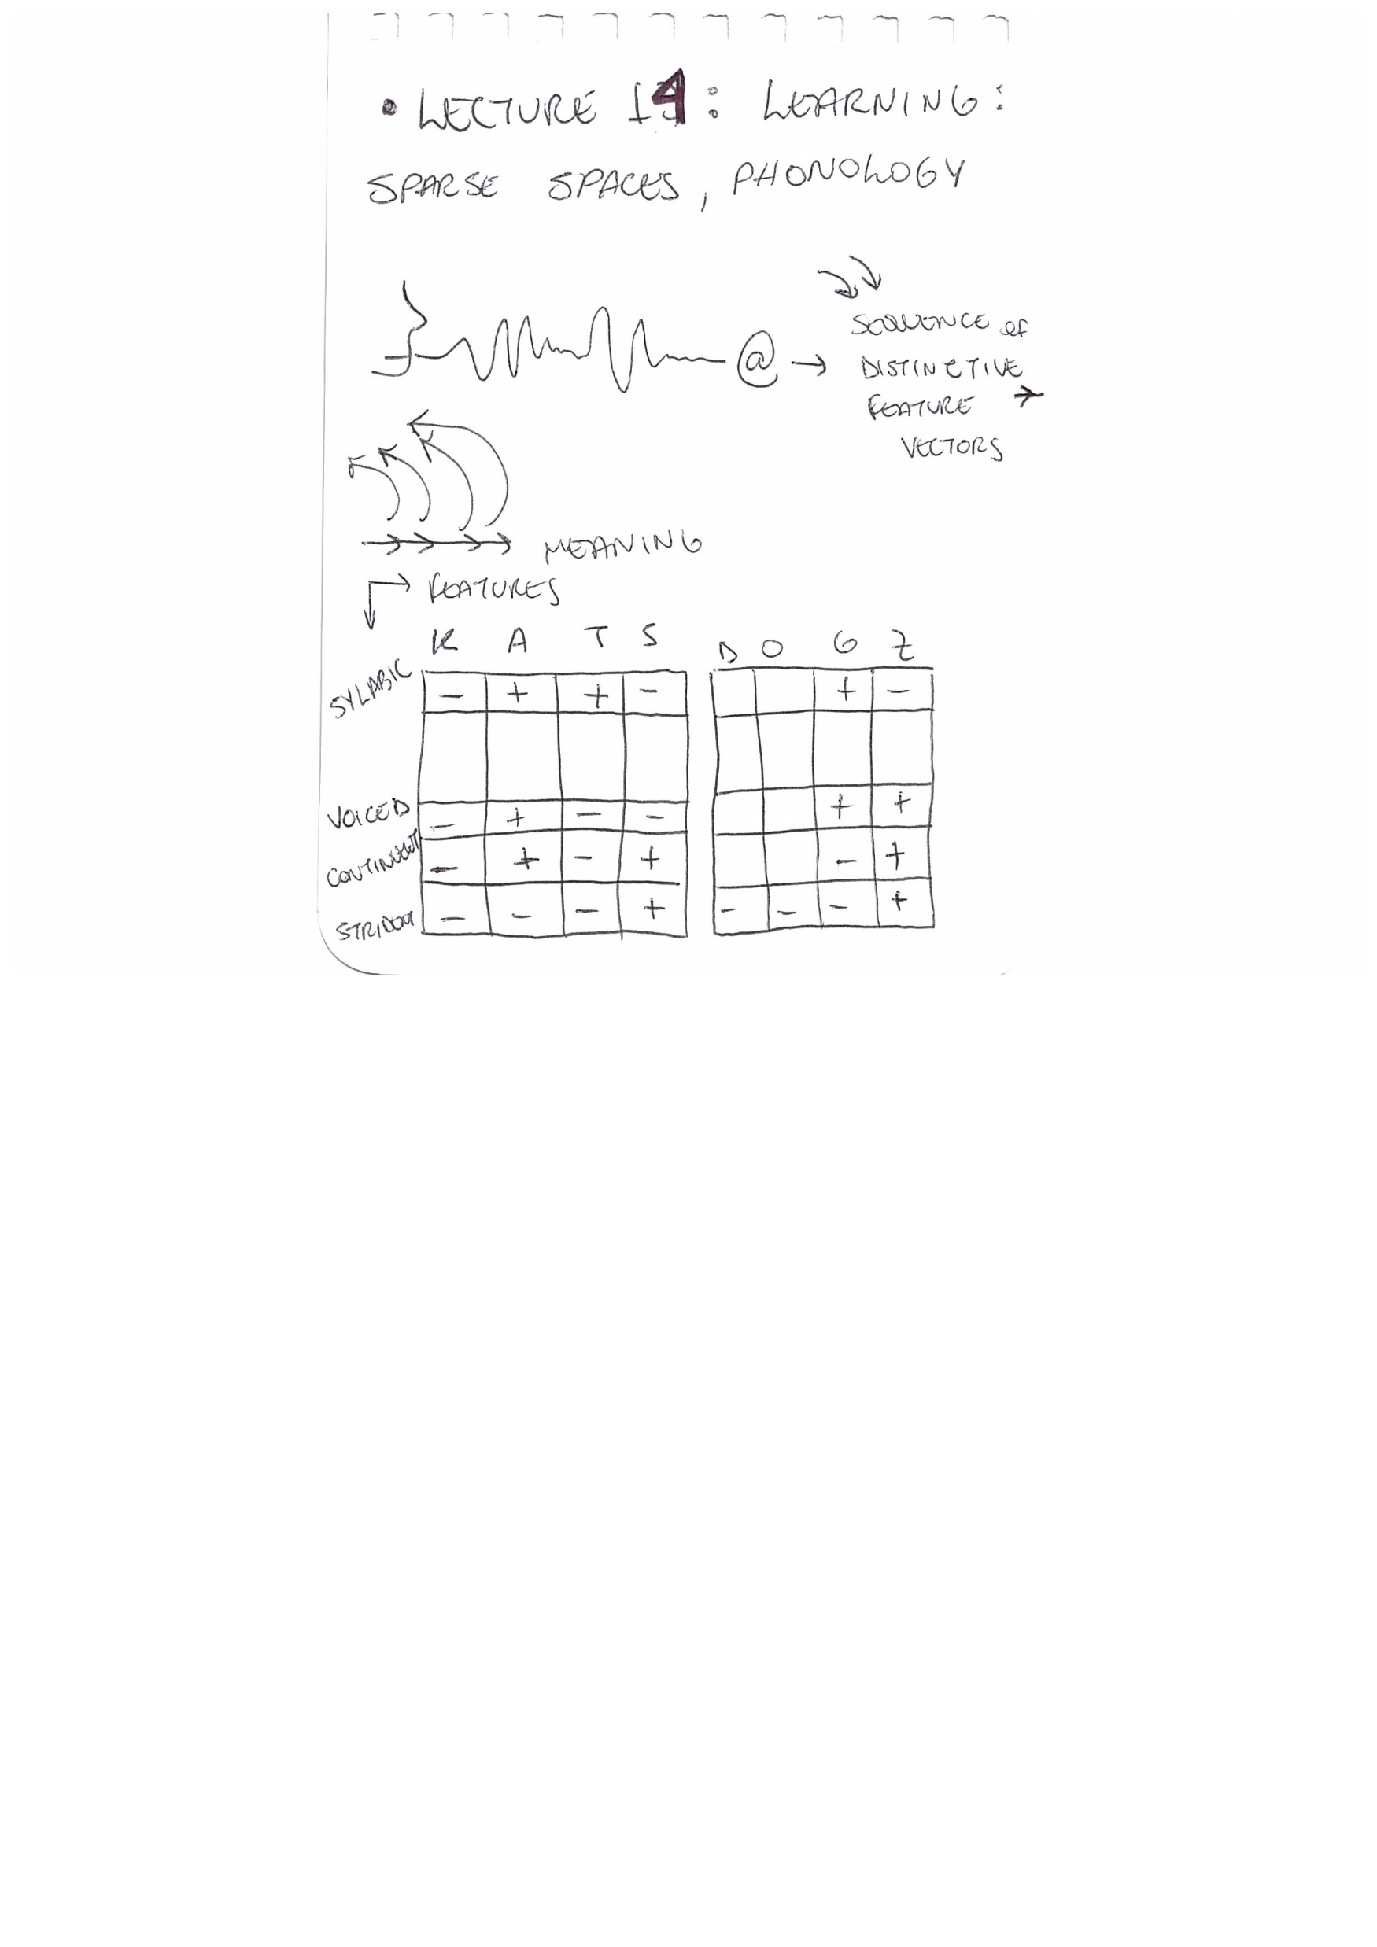
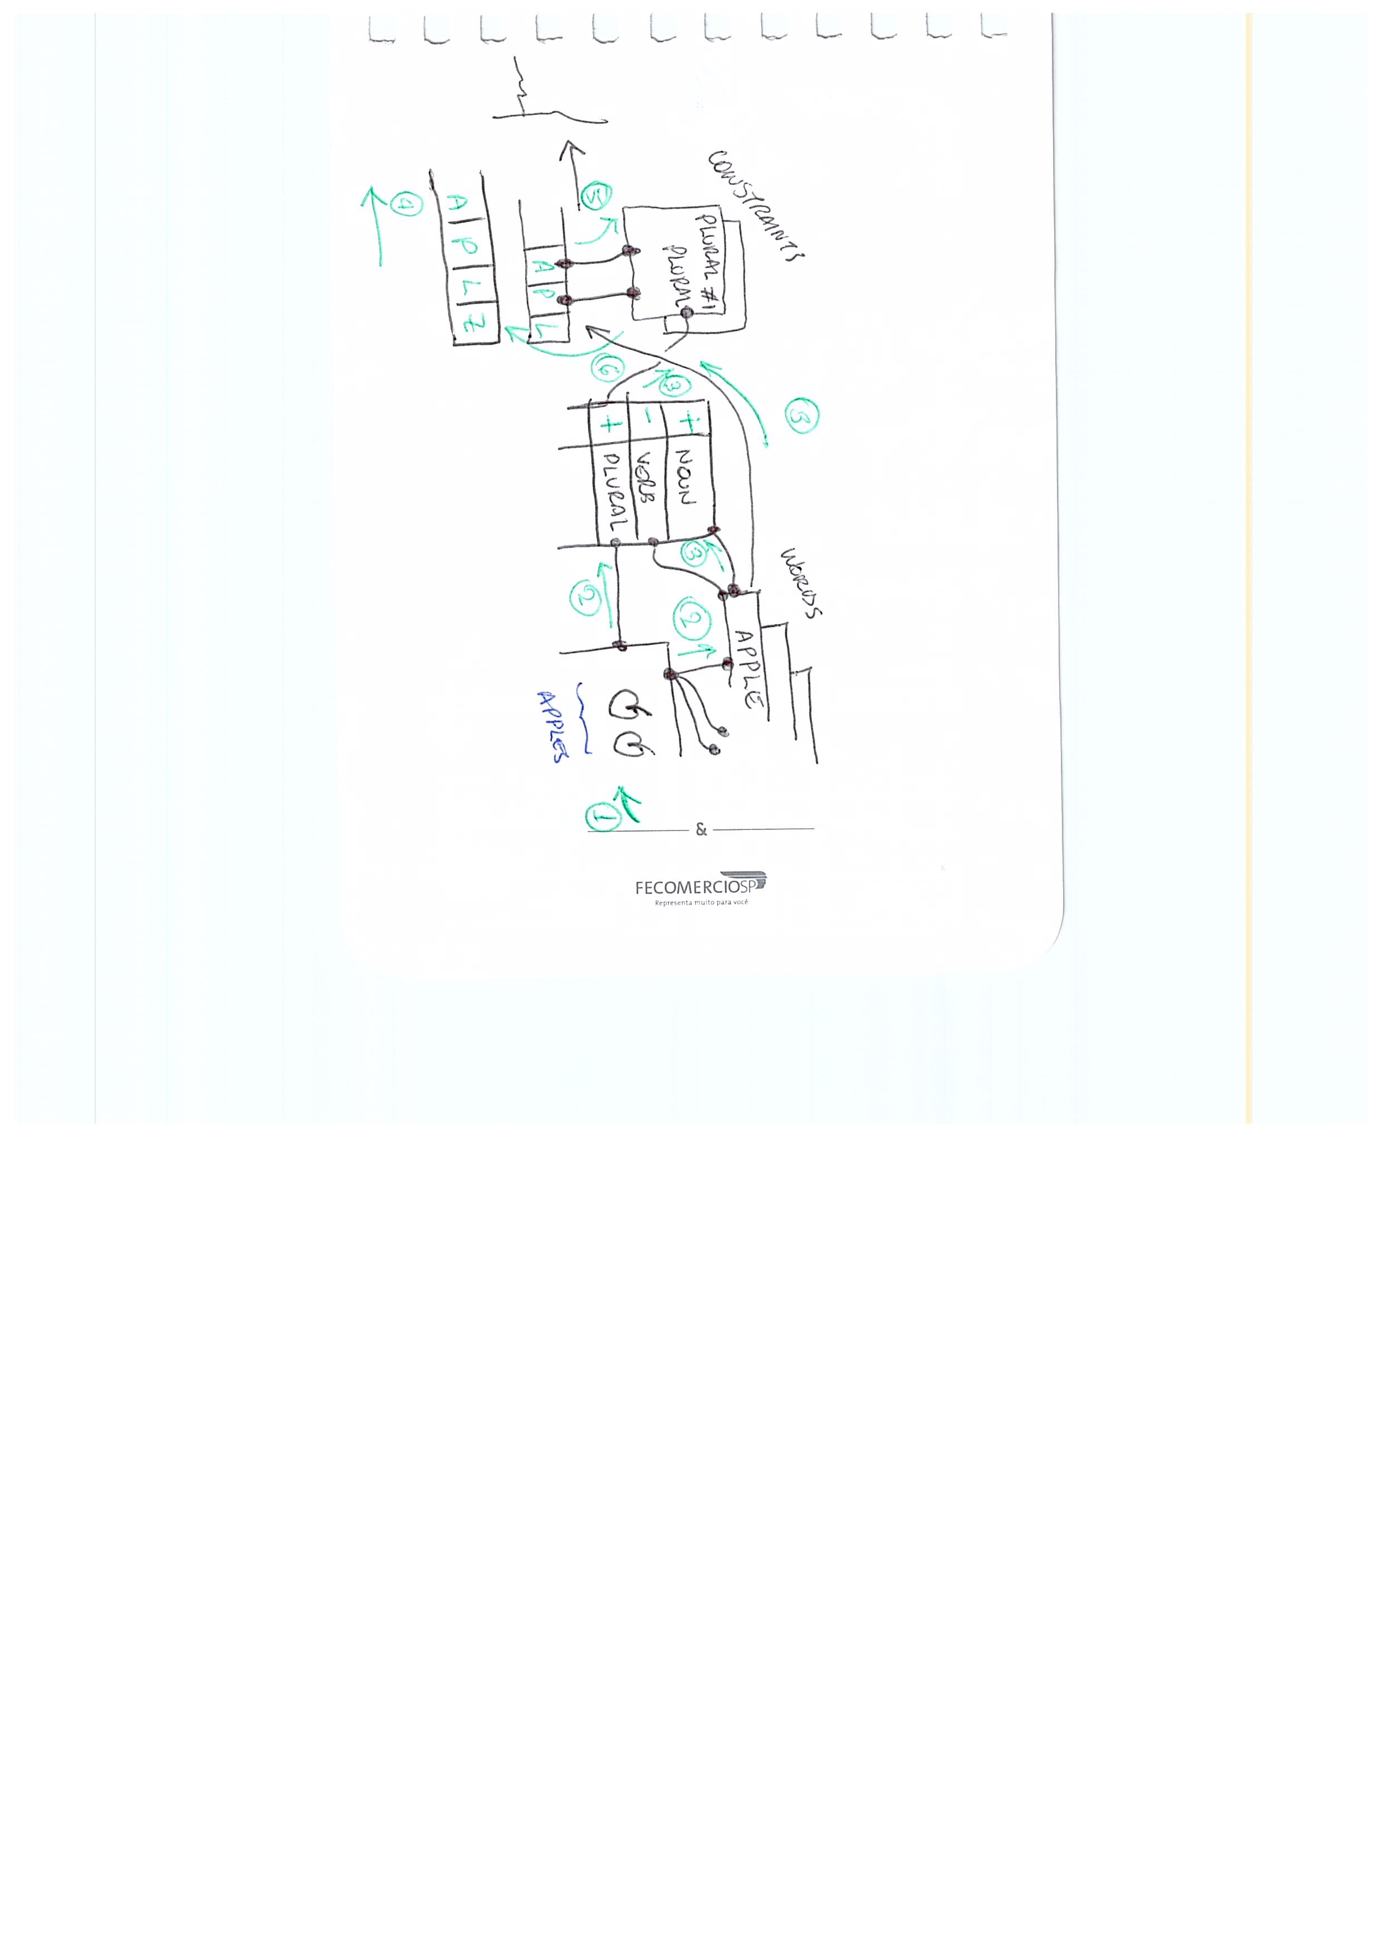
Lecture 14: Learning: Sparse Spaces, Phonology

Slide 19
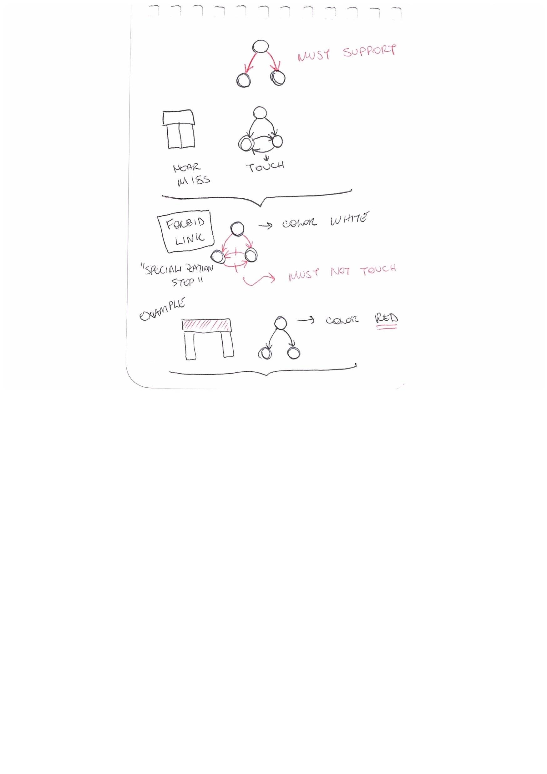
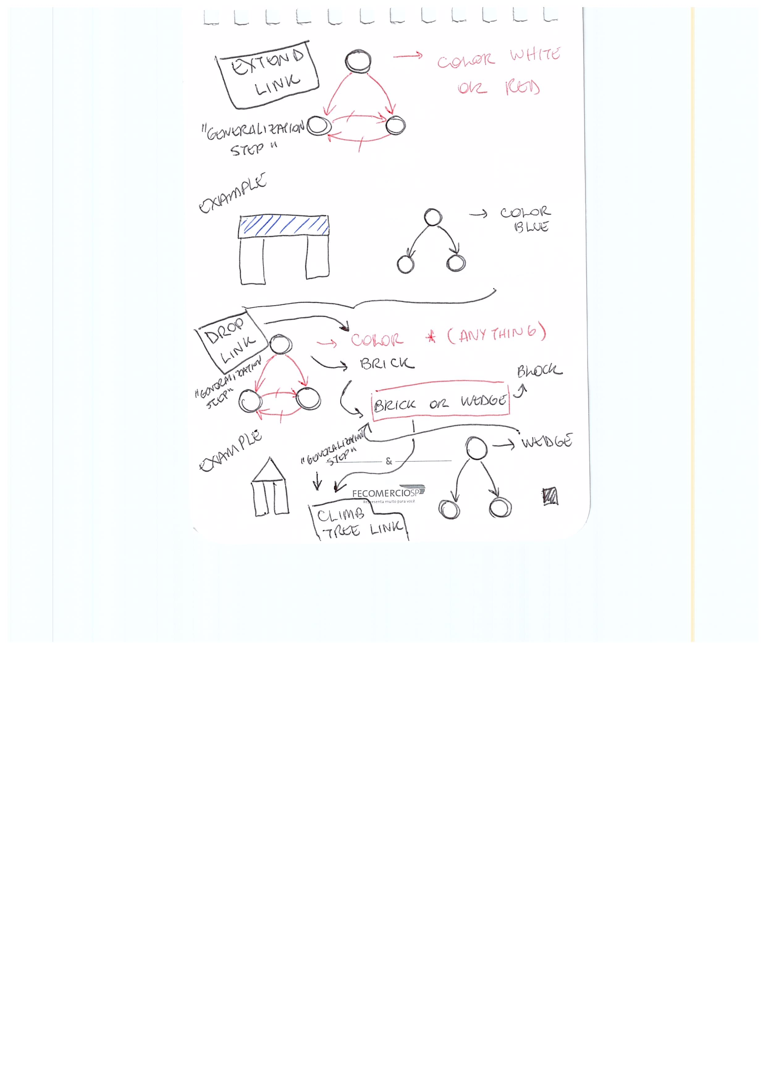
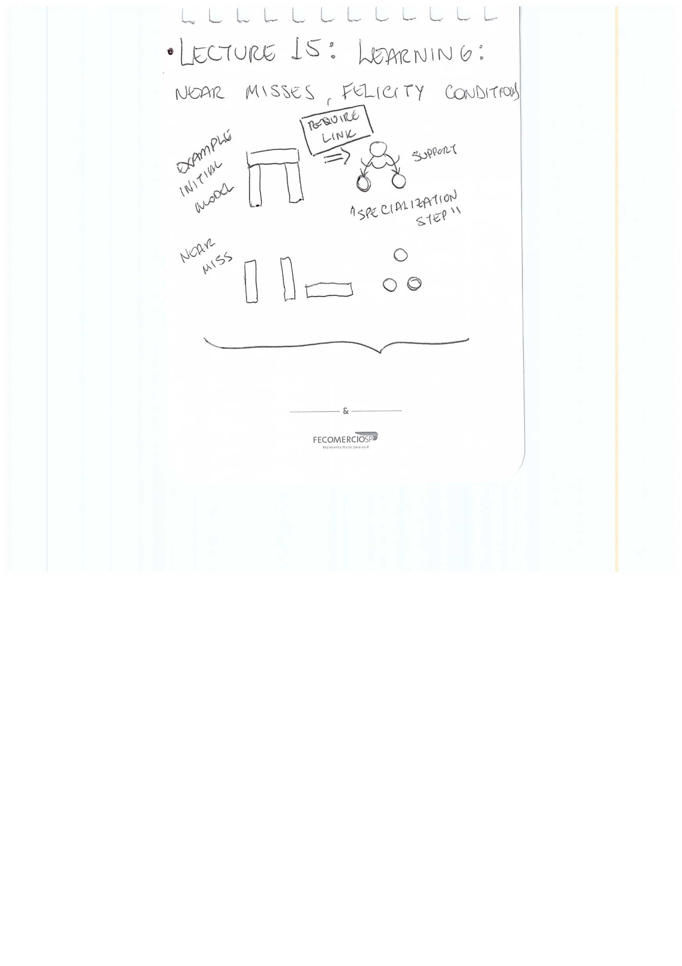
Lecture 15: Learning: Near Misses, Felicity Conditions

Slide 20
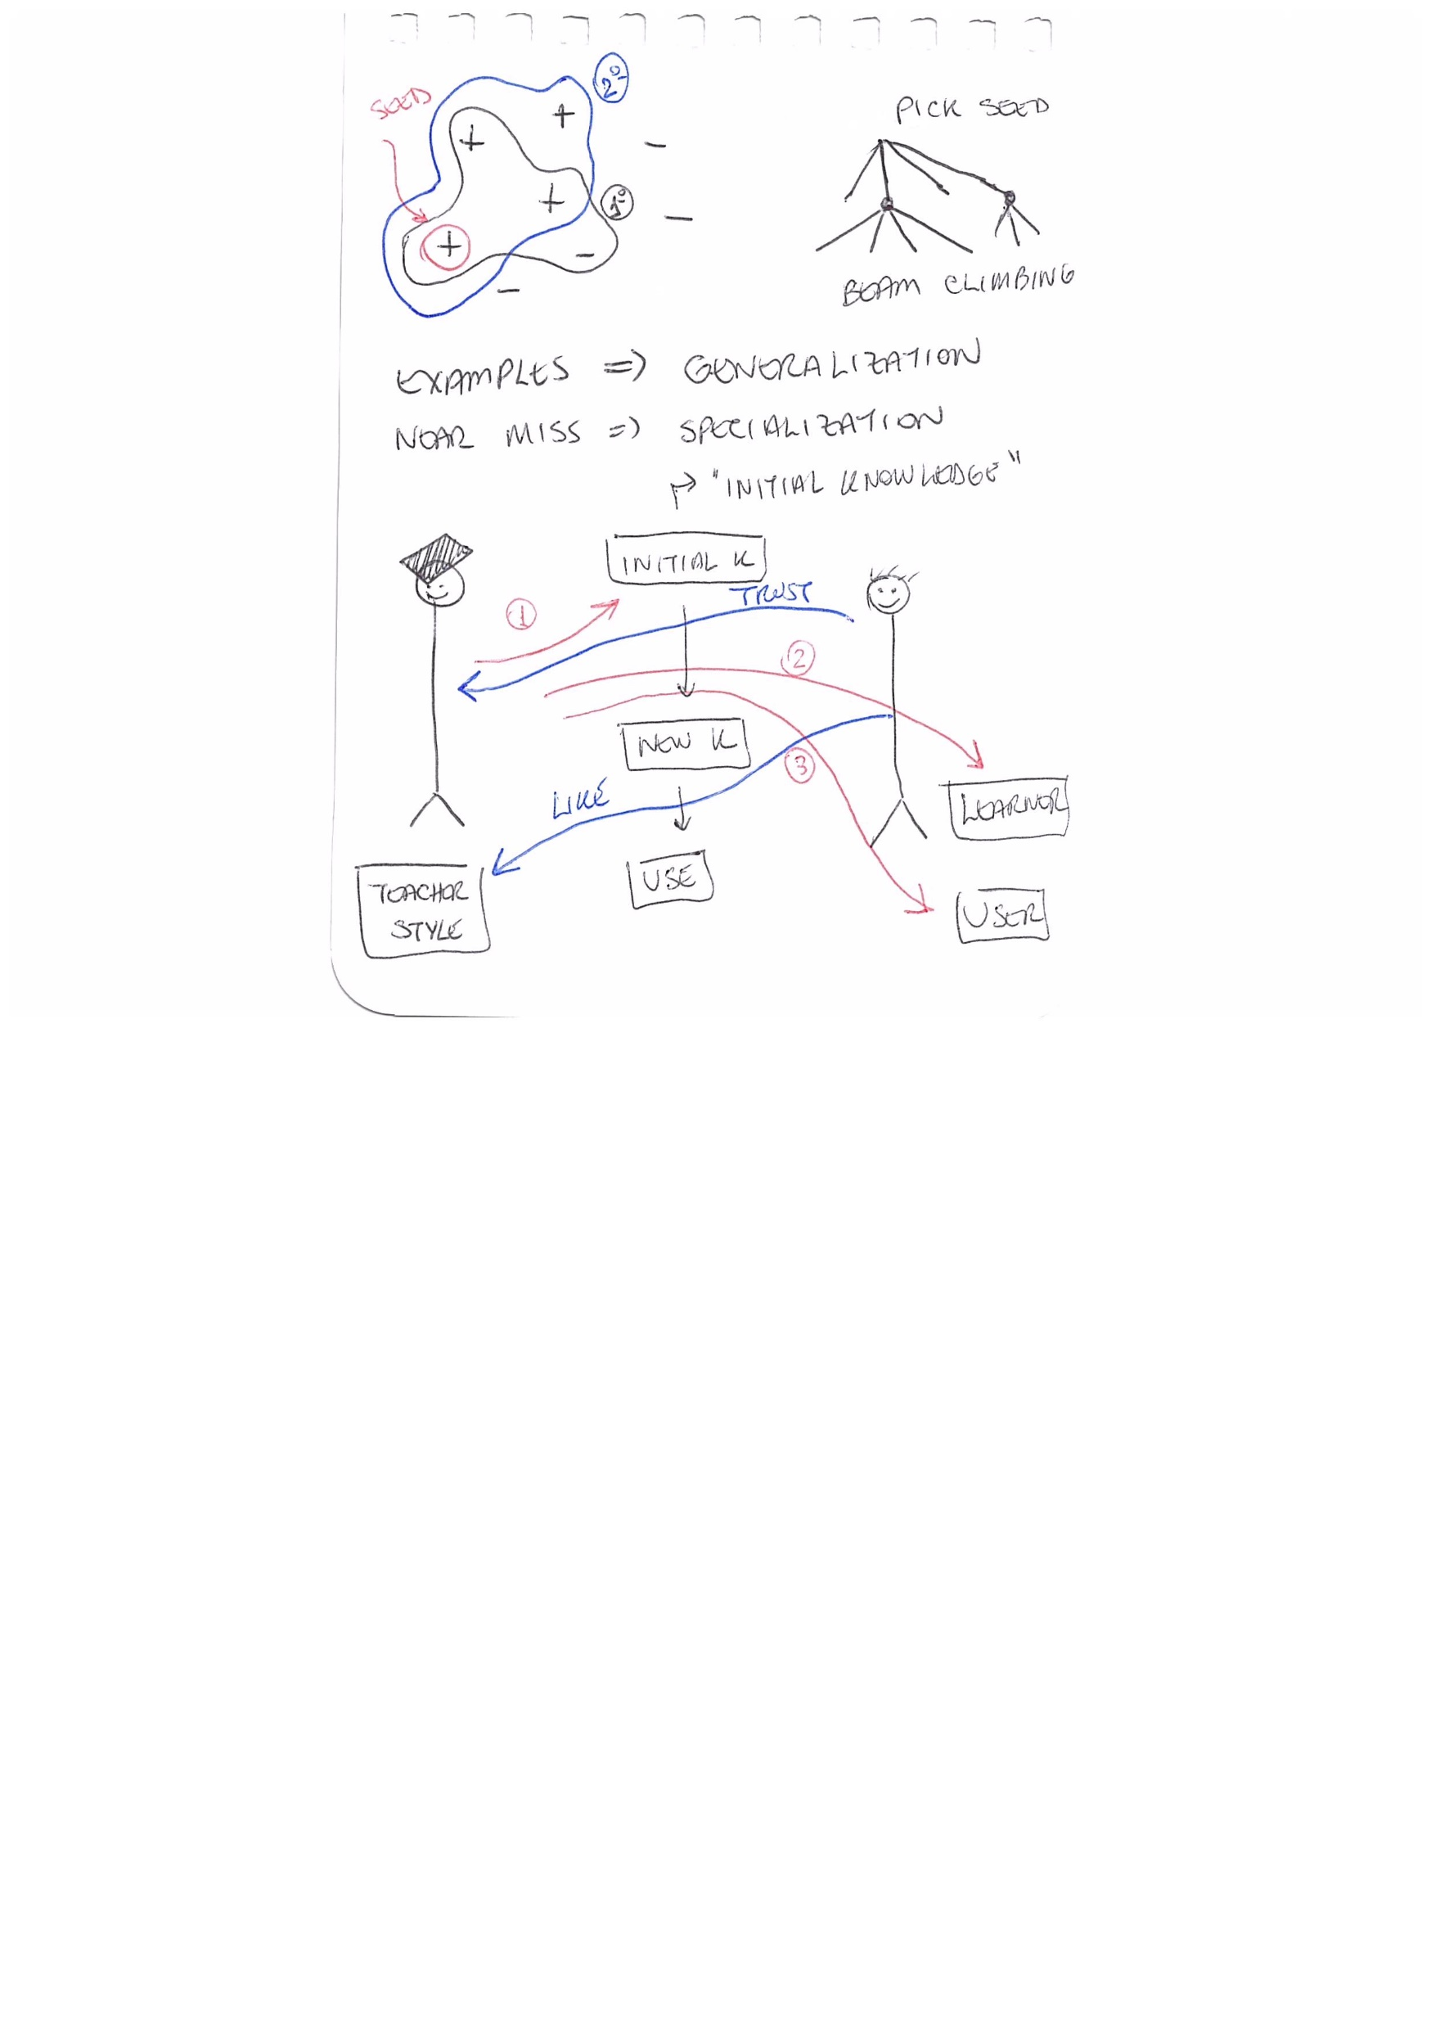
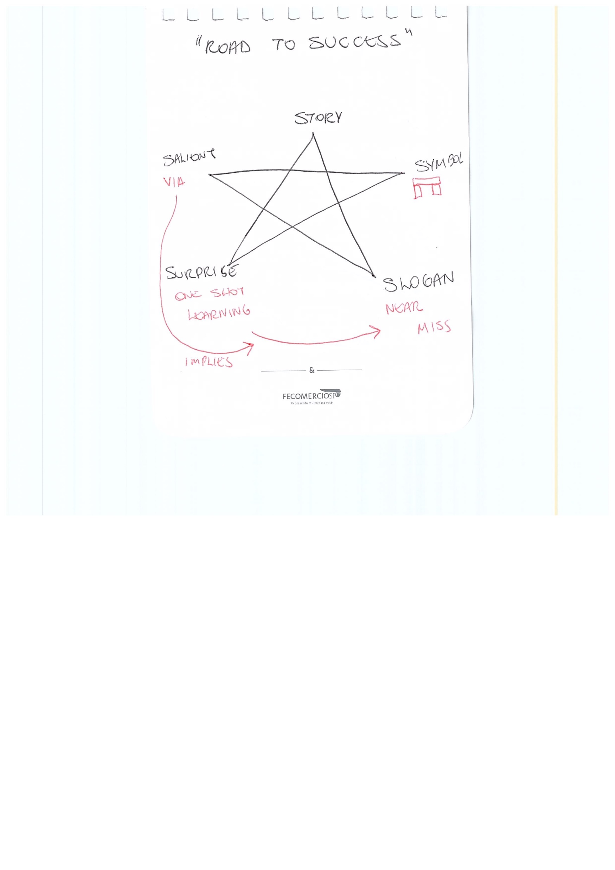
Lecture 15: Learning: Near Misses, Felicity Conditions

Slide 21
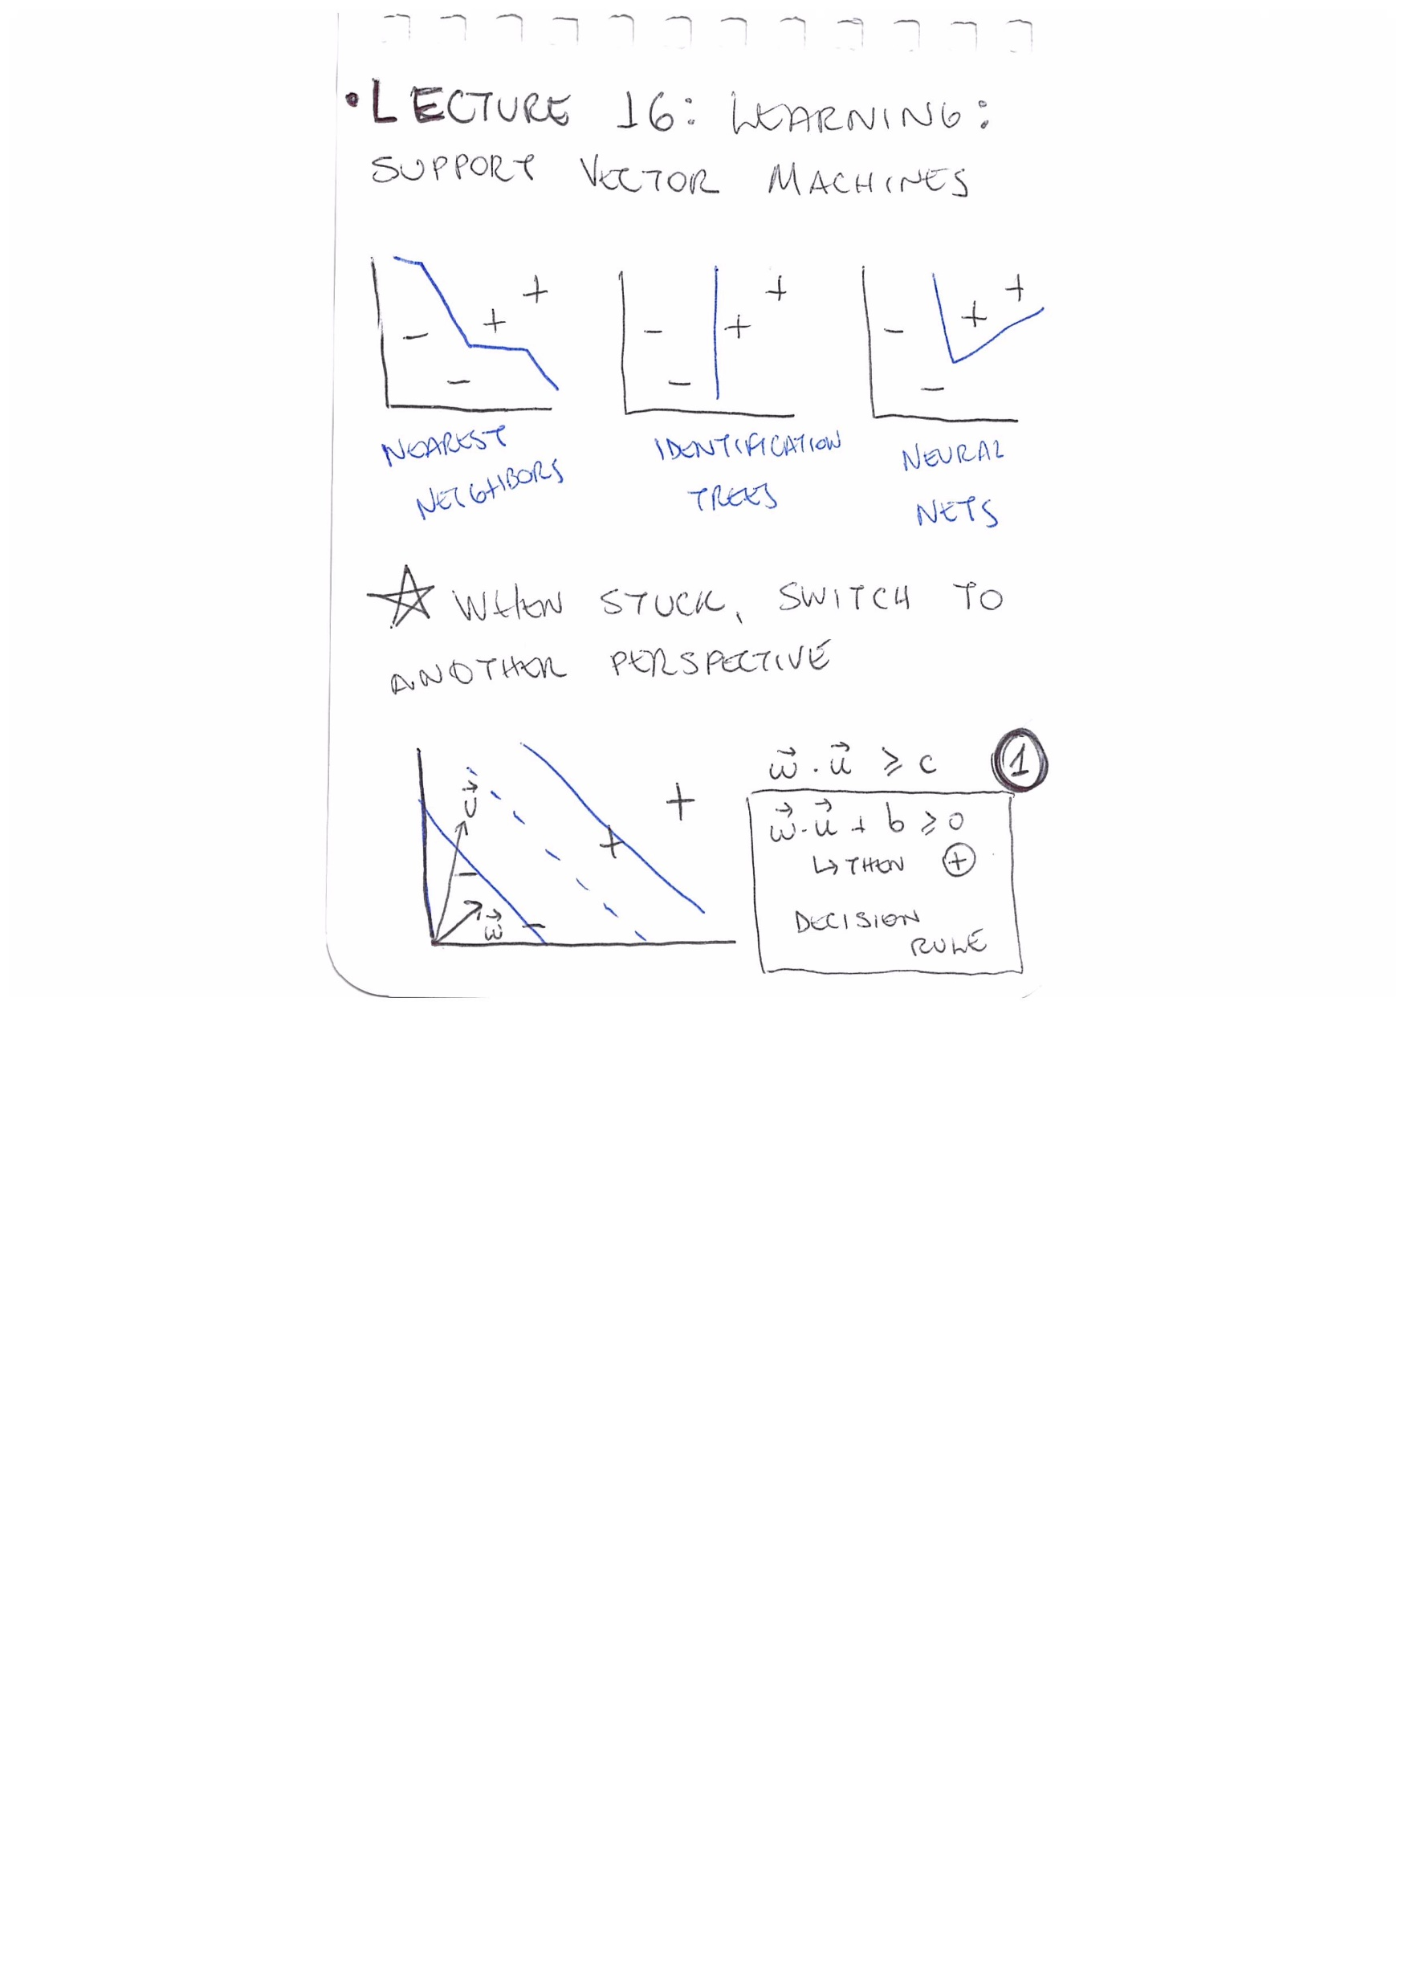
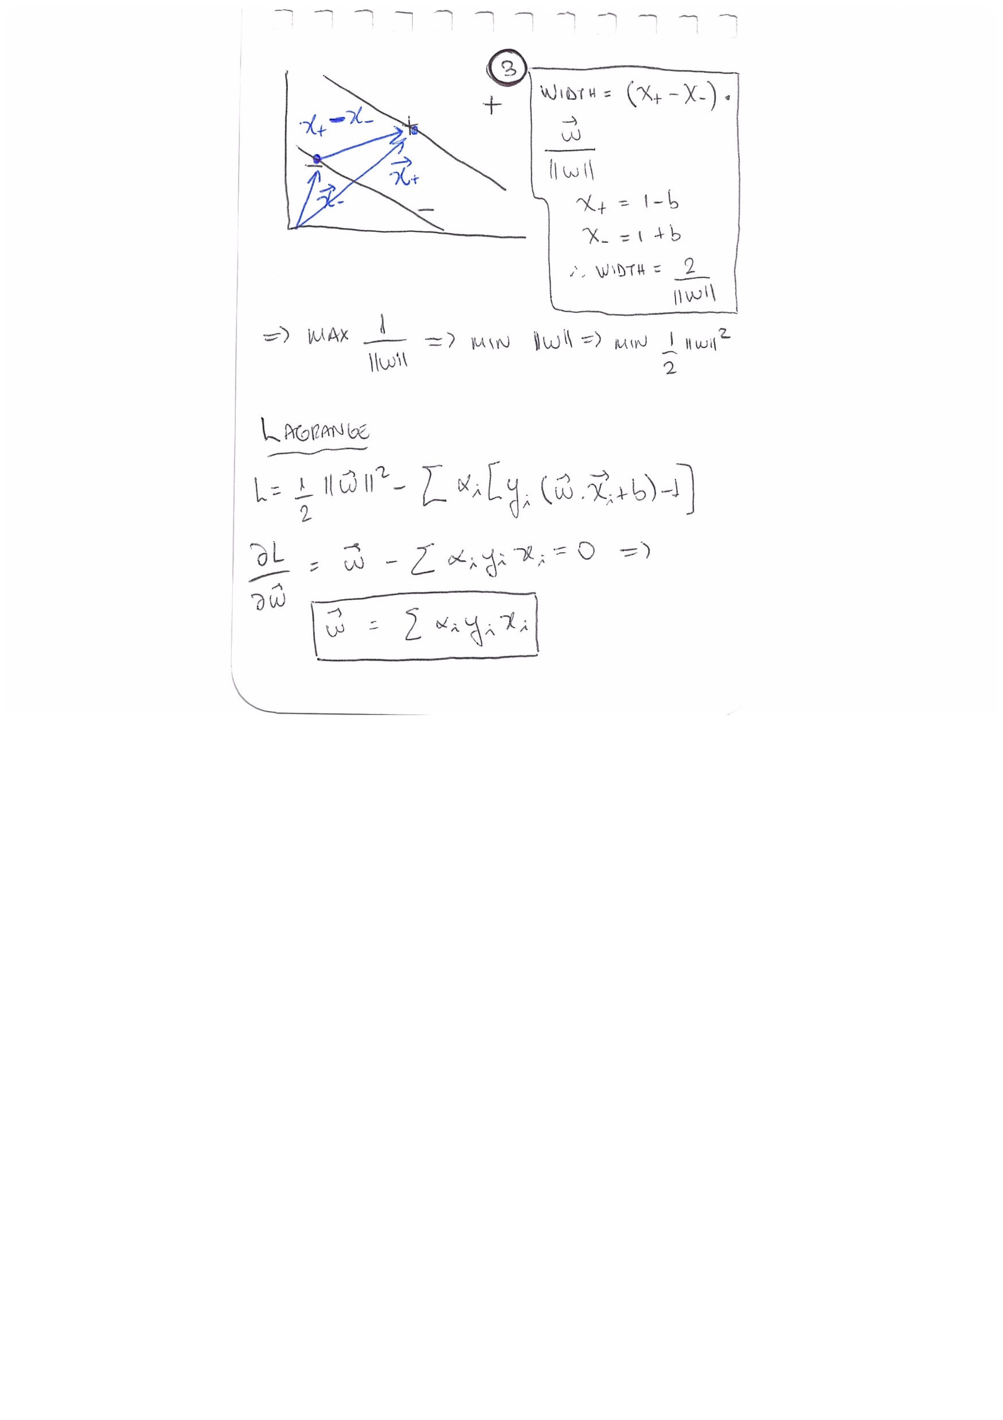
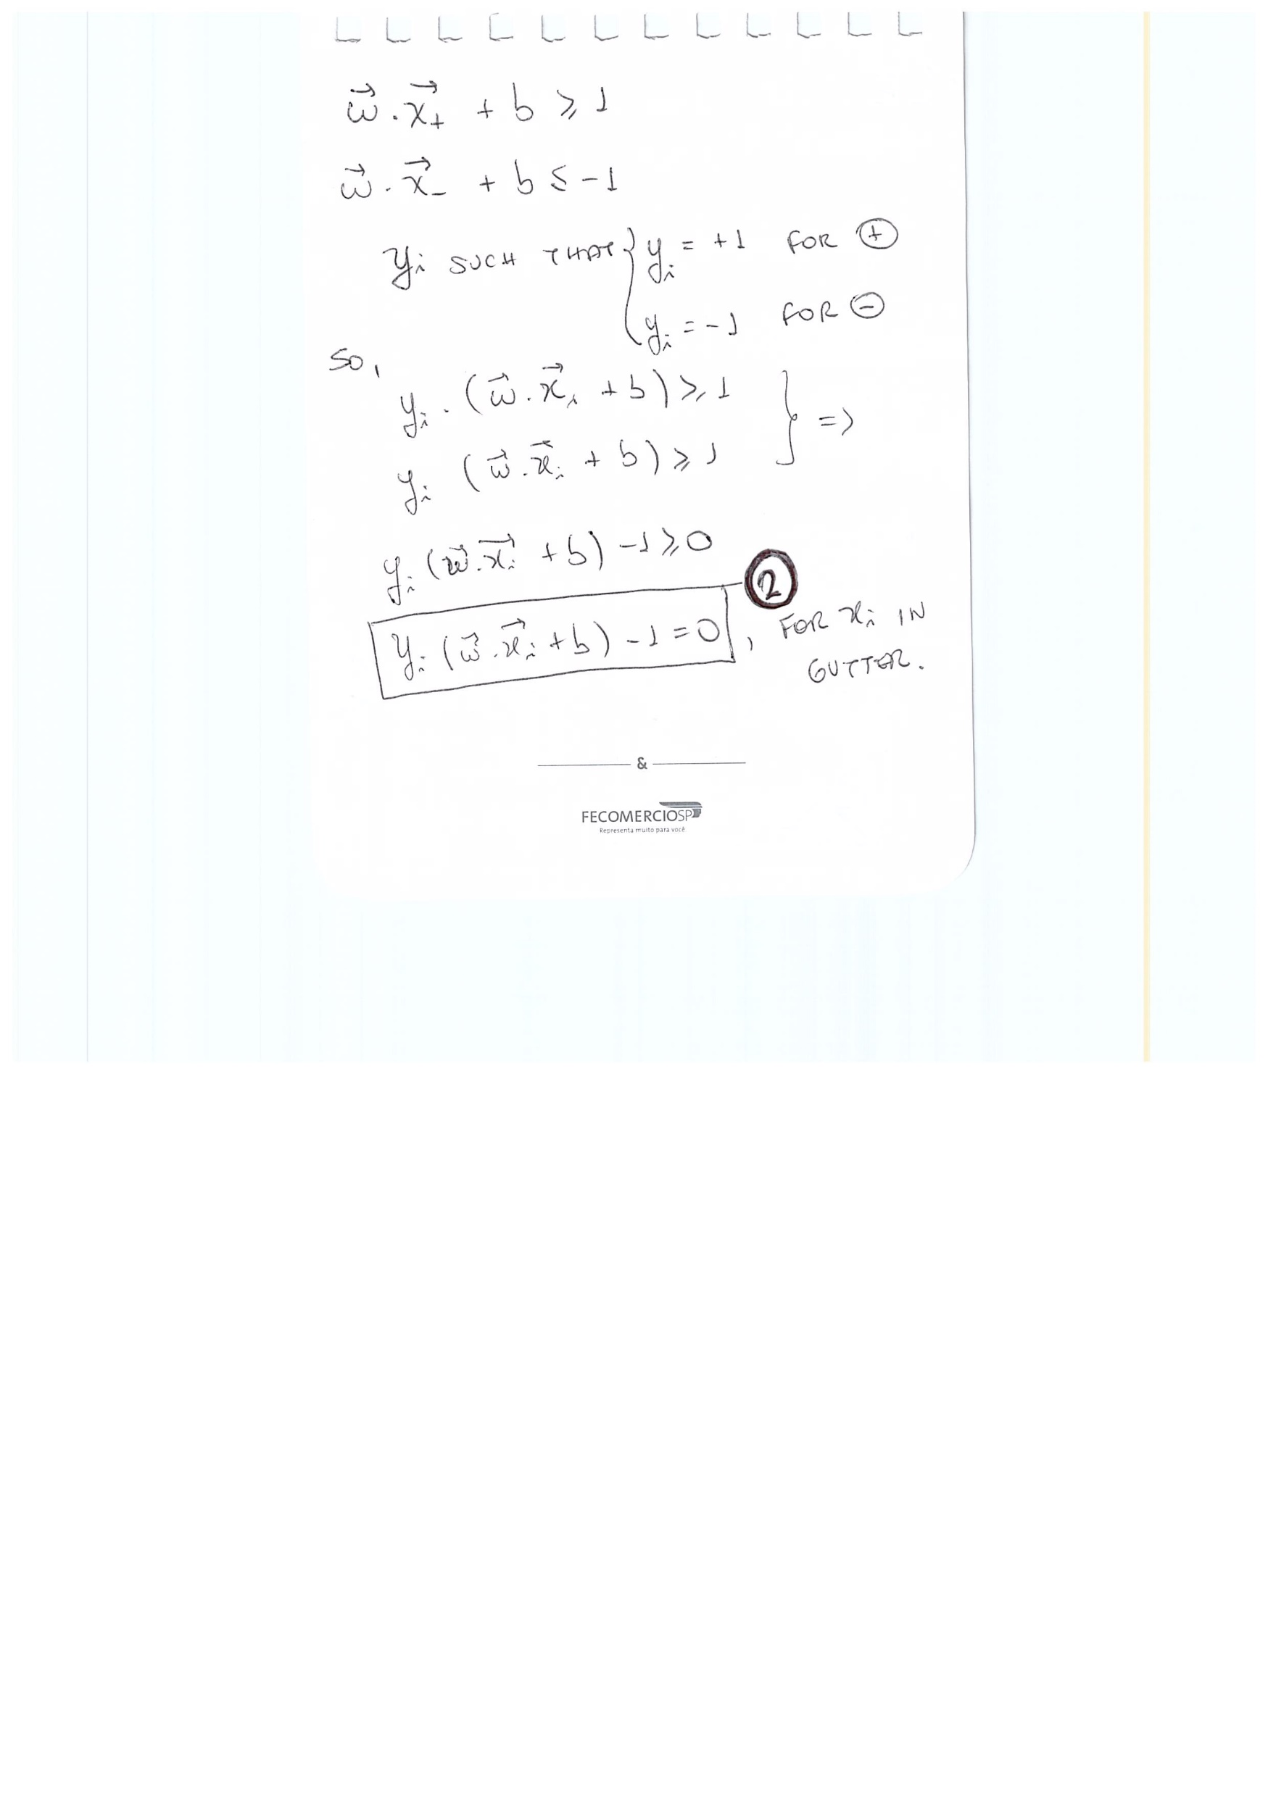
Lecture 16: Learning: Support Vector Machines

Slide 22
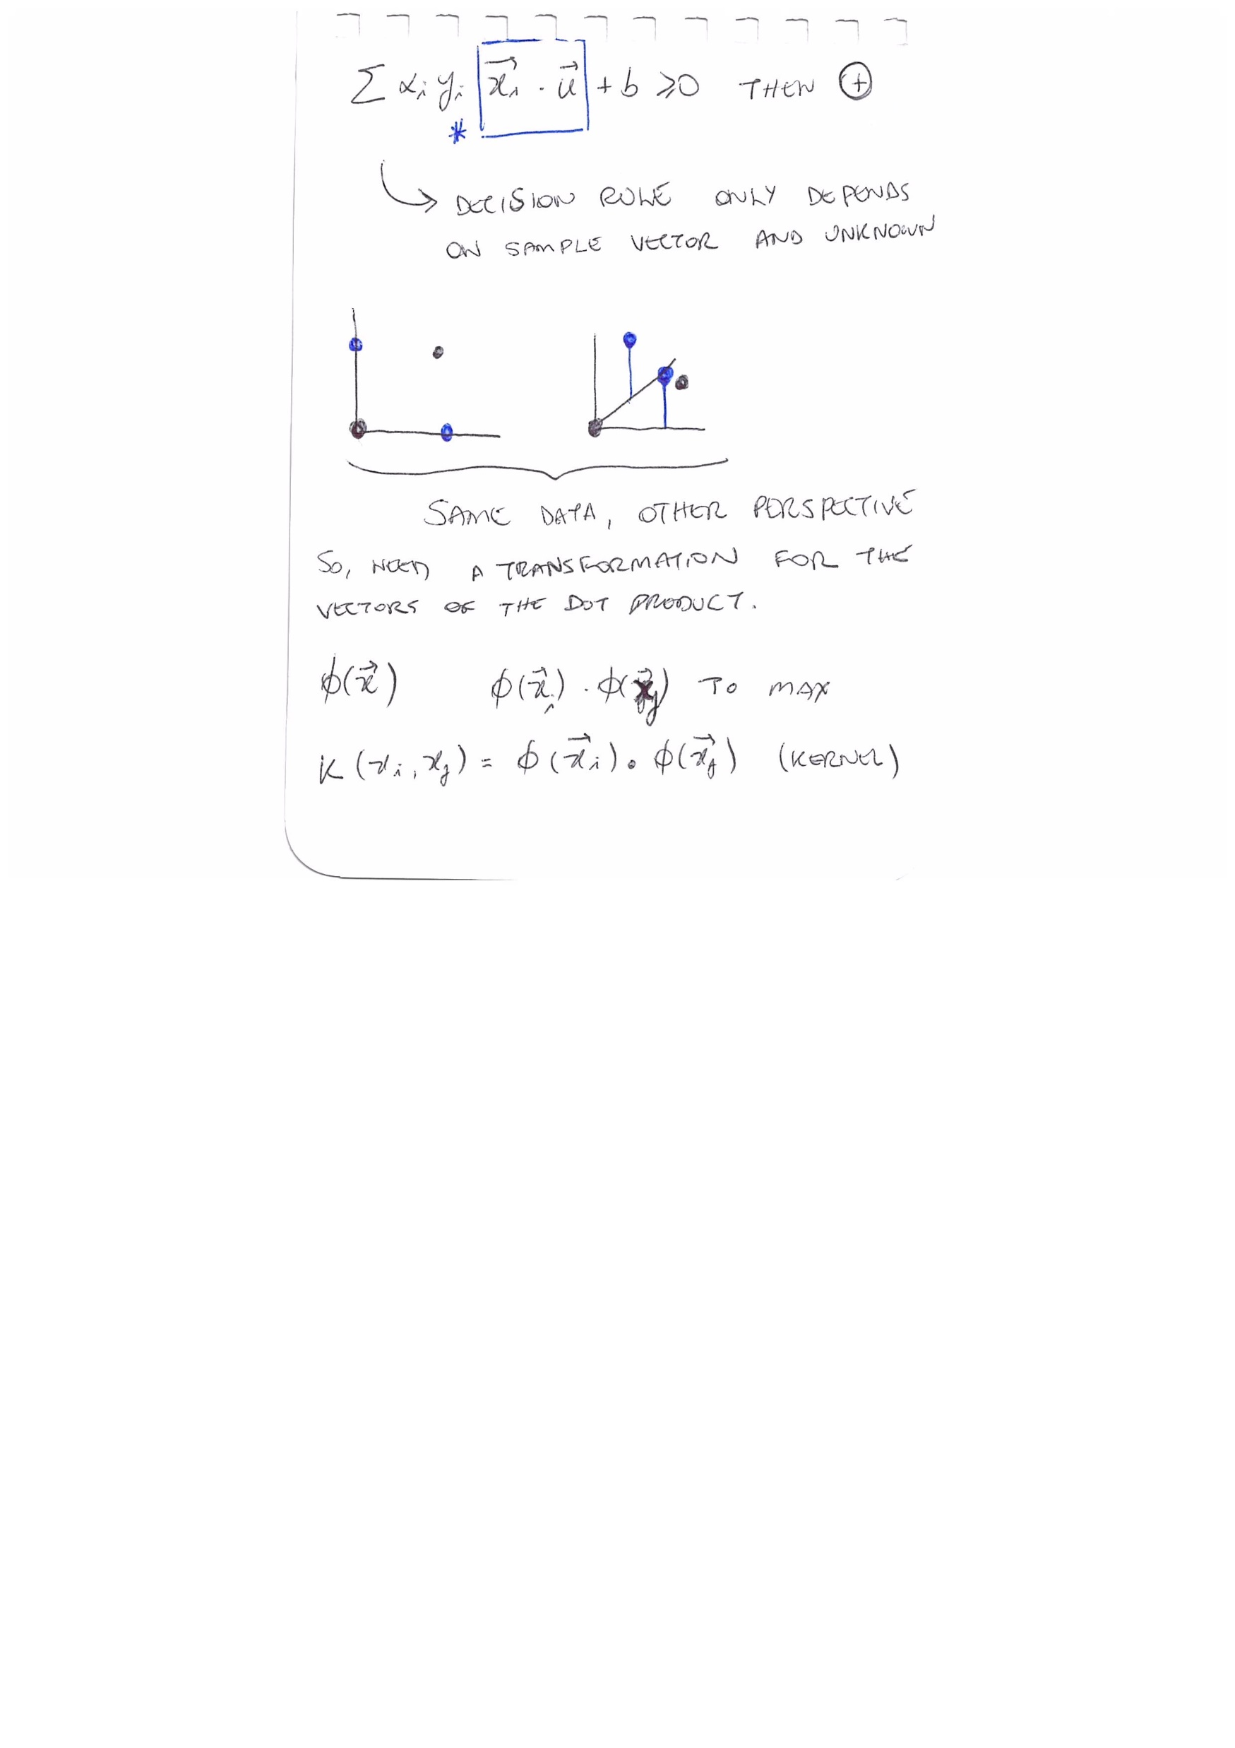
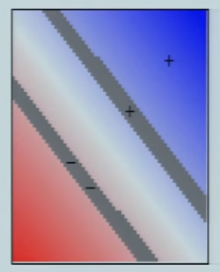




Lecture 16: Learning: Support Vector Machines

Slide 23



Lecture 17: Learning: Boosting

Slide 24


Lecture 17: Learning: Boosting

Slide 25

Lecture 18: Representations: Classes, Trajectories, Transitions

Slide 26


Lecture 19: Architectures: GPS, SOAR, Subsumption, Society of Mind

Slide 27



Lecture 21: Probabilistic Inference I

Slide 28





Lecture 21: Probabilistic Inference I

Slide 29



Lecture 22: Probabilistic Inference II

Slide 30


Lecture 23: Model Merging, Cross-Modal Coupling, Course Summary

